Slide 1
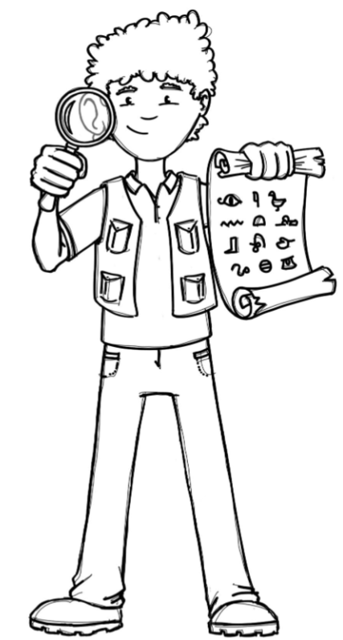
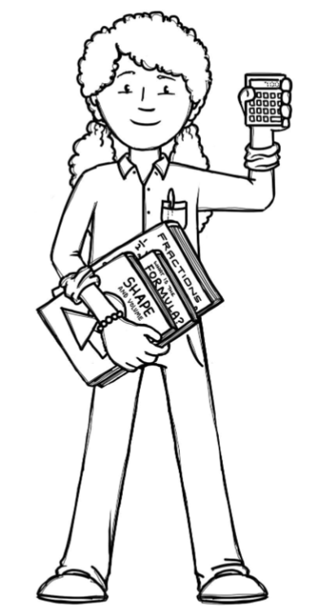
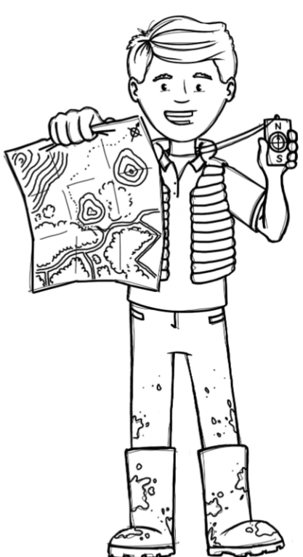
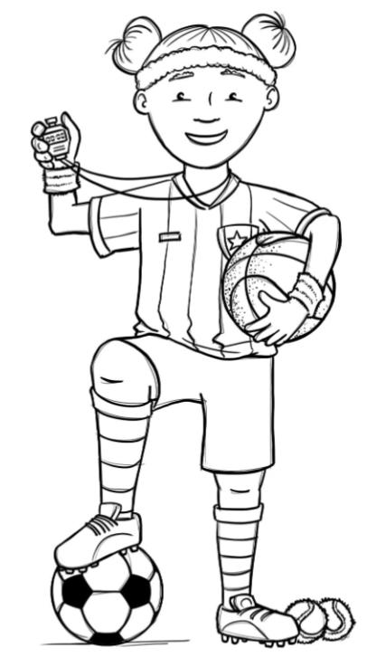
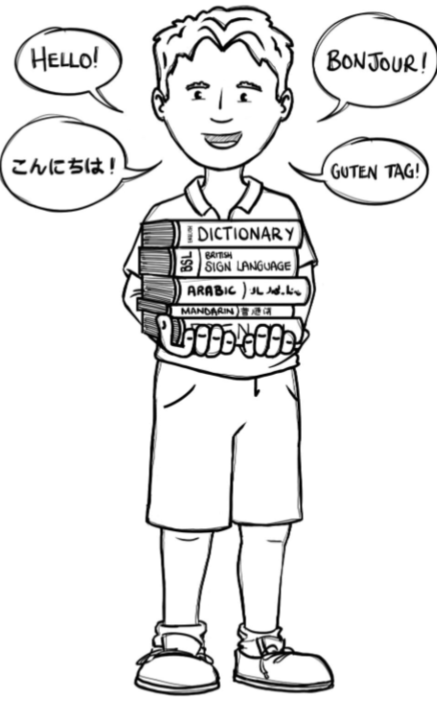
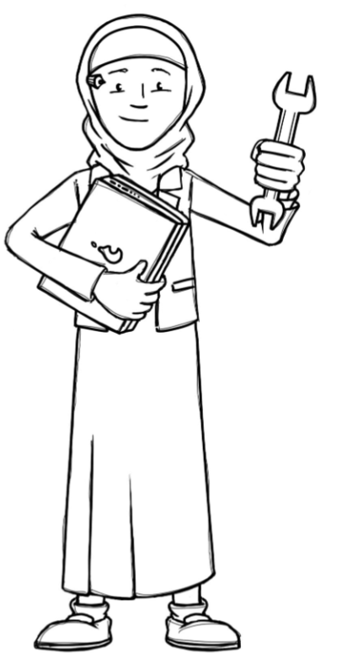
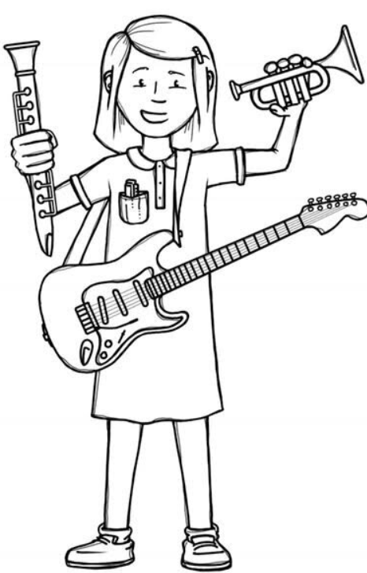
Badgers Class Curriculum Overview—Autumn 2
Enquiry 1:How can we find out about people in Bourton in the past?
Being Mathematicians
Being Authors and Readers
Being Historians
Reading for Pleasure –The Wild Way Home
Stone Age Boy – Narrative
Non-Chronological report - Earthquakes
Poetry - Limericks and Clerihews
Grammar – Revisiting Autumn 1 and extending by using figurative language (onomatopoeia, alliteration, simile, rhyme, repetition, emotion). Year 4 also identify pronouns and use them in writing.
Punctuation – Revisiting Autumn 1 and extending by writing command and statements. Beginning to use commas after subordinate clauses when they are place at the start of a sentence.
Composition – Use ideas from their reading and modelled examples to plan their own writing, proofread, compose and rehearse sentences orally. Year 4 also draft, redraft and edit their writing and organise their writing into paragraphs around a theme.
Addition and Subtraction:
Addition and subtraction up to 4-digit numbers
Estimating answers and inverse operations
Efficient methods
Multiplication and Division:
-Revisiting and extending knowledge of times tables up to 12x12.
-Multiply by 1 and 0
–Divide a number by 1 and itself
Area:
-Find the area of a shape
-Comparing area
Local history study – Using a range of historical sources to explore the lives of people in Bourton in the past
-develop a chronological secure knowledge and understanding of British, local and world history, establishing clear narrative within and across the periods they study.
-note connections, contrasts and trends over time and develop the appropriate use of historical terms
–address and sometimes devise historically valid questions about change, cause, similarity and difference and significance
-understand how our knowledge of the past is constructed from a range of sources
Being Geographers
Being Philosophers
-Use maps and digital/computer mapping to locate places and describe features studied.
- Christianity - How do Christians show that reconciliation with God and others is important?
- Stormbreak/PSHE – Resilience
Being Athletes
Being Artists and Engineers
Invasion games – netball
Fitness – balance, coordination and strength
Being a Musician
Being computer scientists
D&T: Evaluate
-understand how key events and individuals in design and technology helped shape the world
Artists:
-improve their mastery of art techniques - focus on painting
-learn about great artists, architects and designers in history.
Being Linguists
- Creating media – develop an understanding of stop frame animation by investigating if a picture can move.
Create a flip book and a story board to animate a short story.
- ‘Winter’ from ‘The Four Seasons’, Allegro non molto (1st mvt) by Antonio Vivaldi
- The four seasons

