Slide 1
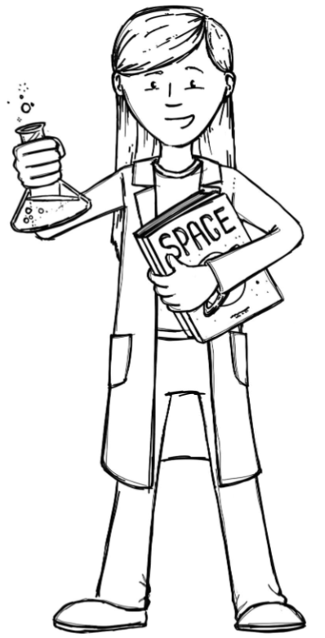
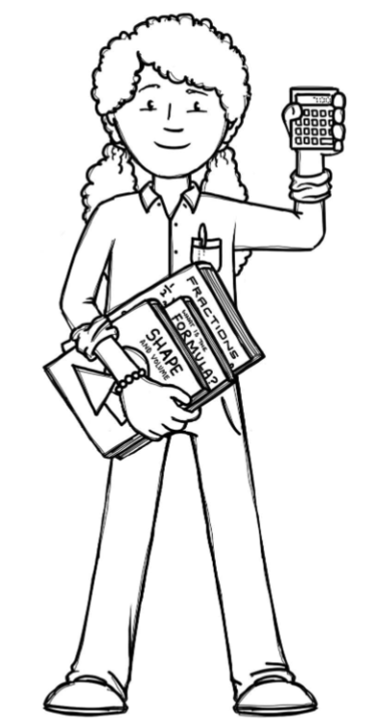
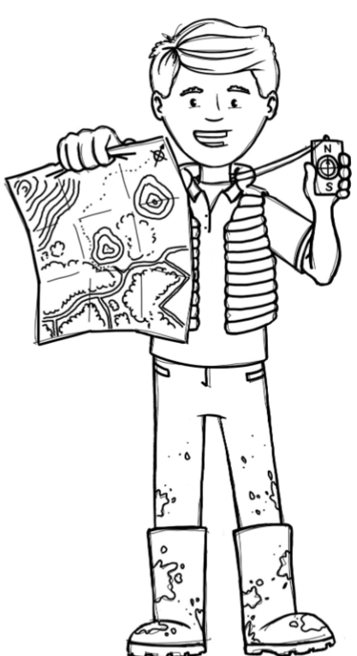
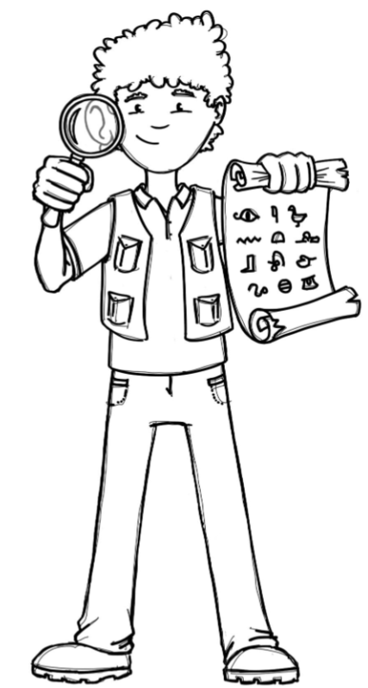
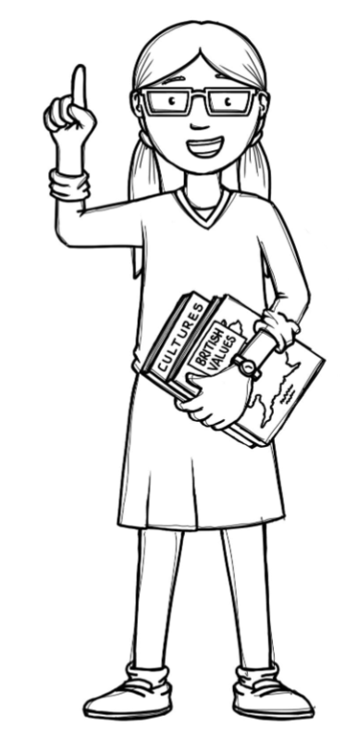
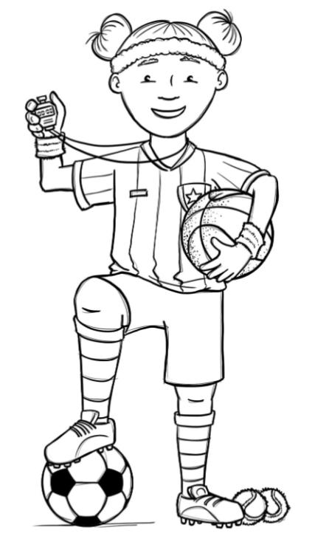
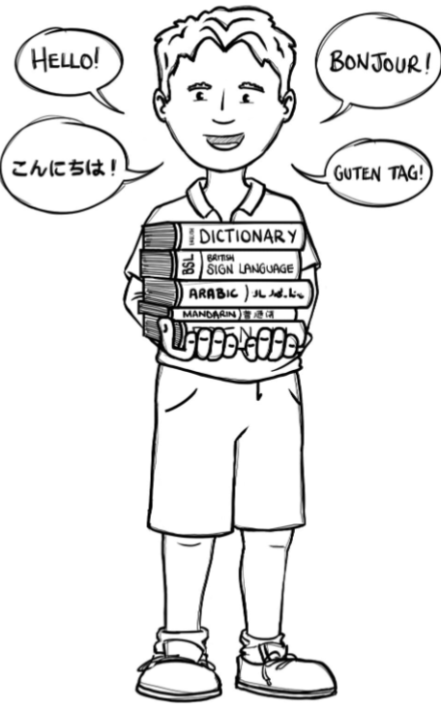
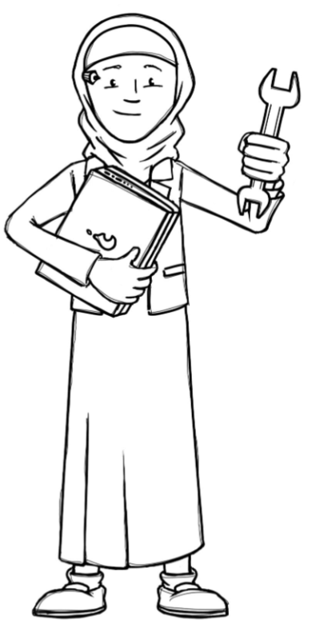
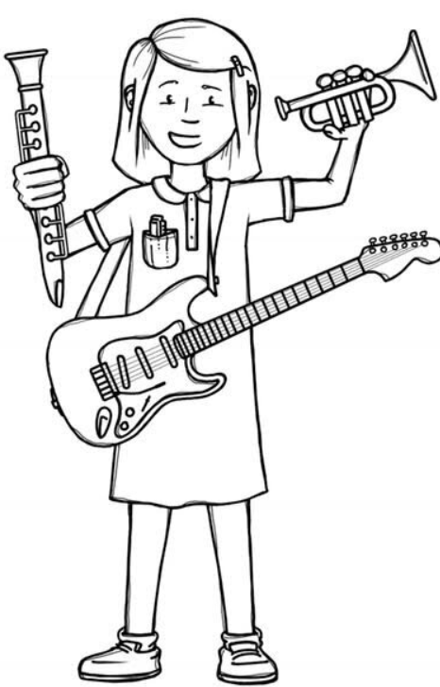
Badgers Class Curriculum Overview—Autumn 1
Enquiry 1: What is a shadow?
Being Mathematicians
Being Authors and Readers
Being Scientists
Reading for Pleasure – Planet Omar
My name is not refugee – Narrative, diary entry and non-chronological report
Free Verse Performance Poetry
Grammar – use subordinating and coordinating conjunctions, use ‘a’ and ‘an’ correctly, use present and past tense correctly, use expanded noun phrases. Year 4 also use future tense correctly, use standard English verb inflections accurately and use adverbs and adverbials.
Punctuation – use inverted commas, use capital letters, full stops, question marks, exclamation marks and commas for a list. Year 4 also use commas after simple fronted adverbials and use apostrophes for contractions and possession.
Composition – Use ideas from their reading and modelled examples to plan their own writing, proofread, compose and rehearse sentences orally. Year 4 also draft, redraft and edit their writing and organise their writing into paragraphs around a theme.
Place Value:
- Represent and partition numbers up to 1,000/10,000
Find 1,10, 100 and 1,000 more or less
Number lines to 1,000/10,000
Compare and order numbers
Rounding to the nearest 10, 100 and 1,000
Roman Numerals
Addition and Subtraction:
Addition and subtraction up to 4-digit numbers
Estimating answers and inverse operations
Efficient methods
-Recognise that light is needed in order to see.
-Understand that dark is the absence of light.
-Notice that light is reflected from surfaces
-Recognise that light from the sun can be dangerous
-Understand how shadows are formed
Working Scientifically: What materials are reflective? How does the size of a shadow change?
Being Historians and Geographers
Where in the world is it daylight all day?
-Identifying the position and significance of the Arctic and Antarctic Circle.
-Explore what life is like in the Arctic and Antarctic Circle.
Being Philosophers
Hinduism – How does the story of Rama & Sita inspire Hindus to follow their
Dharma?
Stormbreak/PSHE - Relationships
Being Athletes
Being Artists and Engineers
Invasion games – Tag Rugby
Cricket taught by coaches
Being a Musician
Being computer scientists
How can our puppet move? What is our puppet made of?
-Use simple linkages and levers to create ‘joints’ of a body or levers to make an object move.
-Use a wide range of tool to perform simple practical tasks (cutting, joining).
Being Linguists
Three Little Birds -
Listening and appraising Reggae music by Bob Marley
Computer Systems & Networks
How computers are connected
How digital devices function
Instruments

