Slide 1
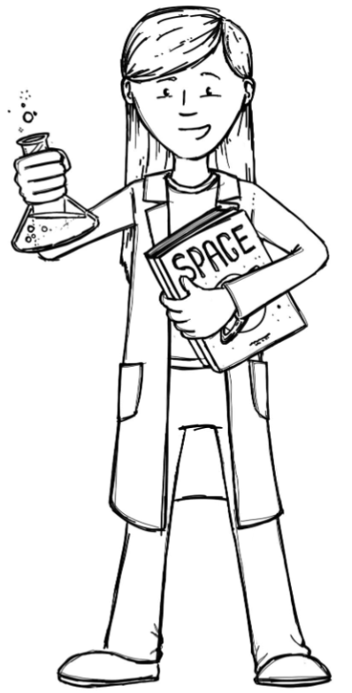
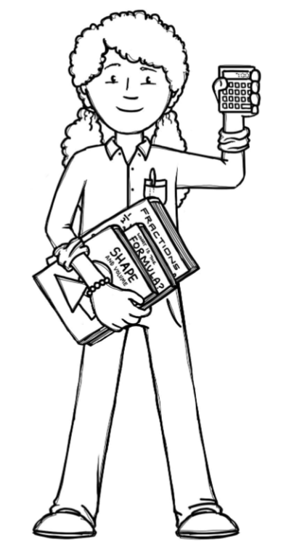
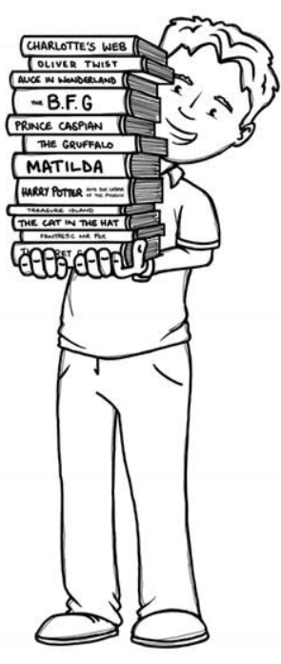
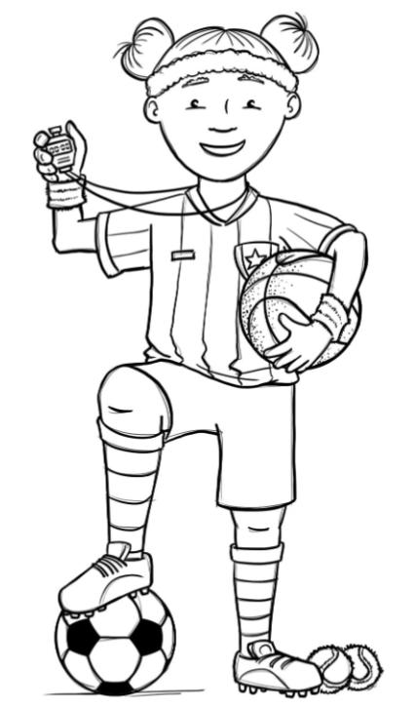
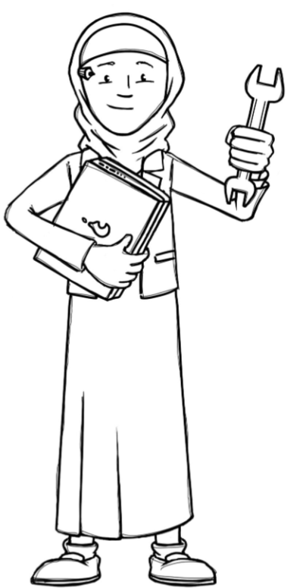
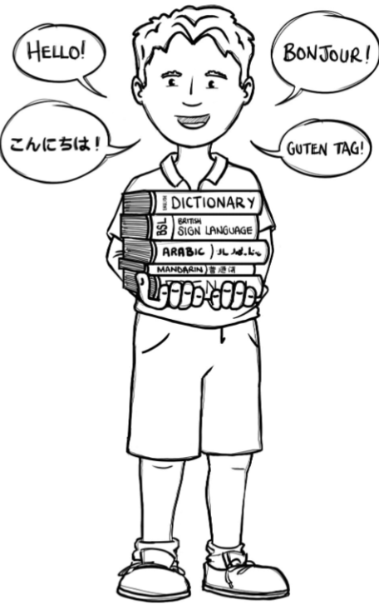
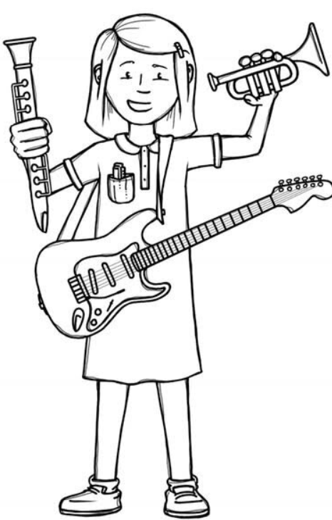
Foxes Class Curriculum Overview—Summer 1
Enquiry 5: What do forces actually do?
Being Mathematicians
Being Authors and Readers
Being Scientists
Area, perimeter and volume
Consolidation/ revision
Position and direction
Being Authors
Eye of the Storm– Narrative
Cracking contraptions – explanation
Free write with a picture – setting description
Being Author Readers
SAT style questions
Comprehension Crushers:
The Ungrateful Snake
Physical Features of North America and Biomes of America
Mini questions within our enquiry
What is a force?
What is gravity?
What is air resistance?
What is water resistance?
What is friction?
Being Philosophers
EMMANUEL – Christianity - what is the great significance of Eucharist in Christians?
SCARF – Being myself
Being Athletes
Being Engineers
Mini questions within our enquiry
How do pulleys and gears work?
What will my design look like?
How can I evaluate my machine?
Cricket – Led by Prime sports
Athletics/ swimming – Led by Teacher
Being computer scientists
Being Linguists
Being a Musician
TEACH COMPUTING
Programming A – selection in physical computing
Clothes
Charanga: developing ensemble skills

