Slide 1
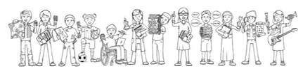

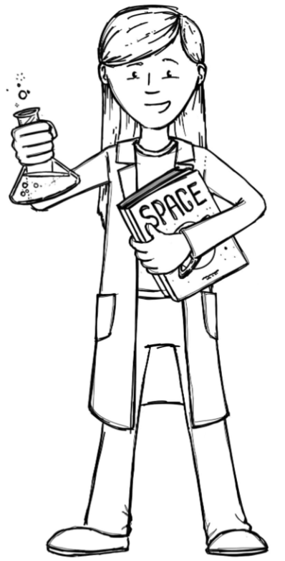
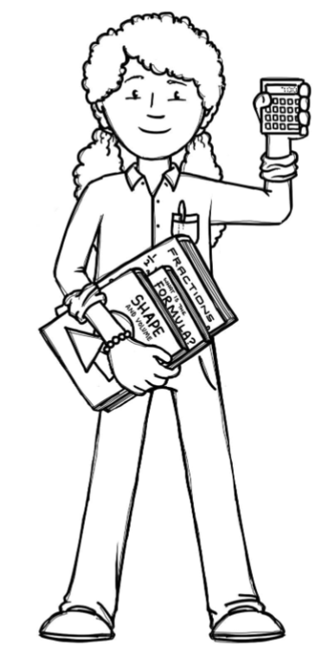
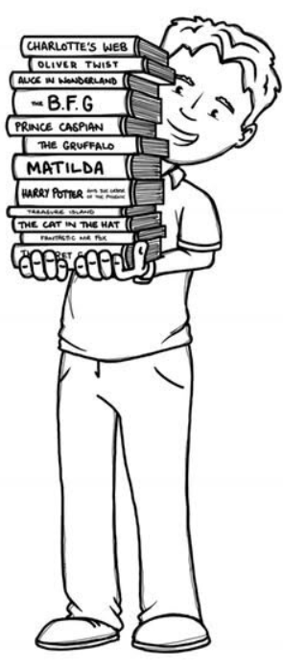
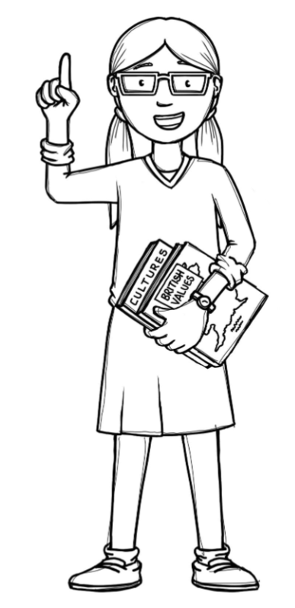
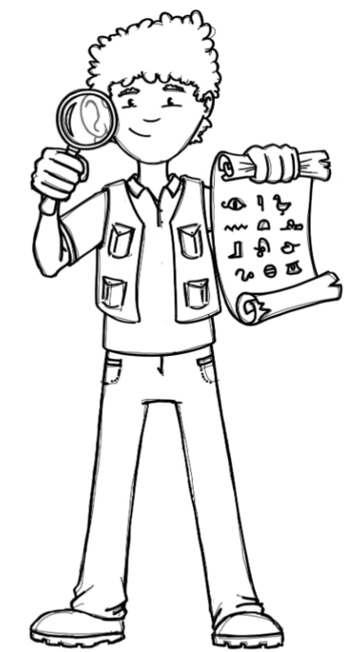
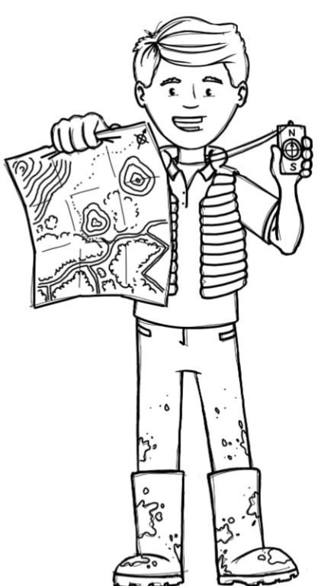
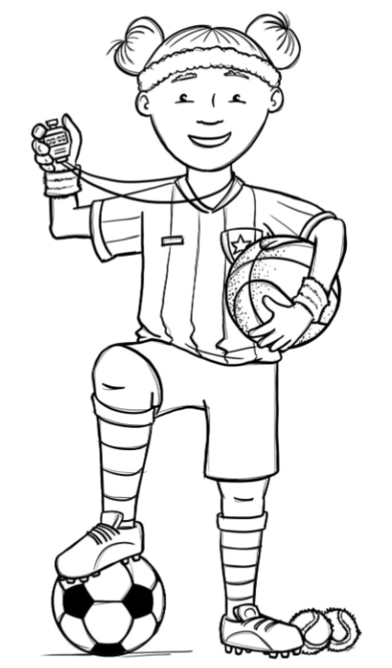
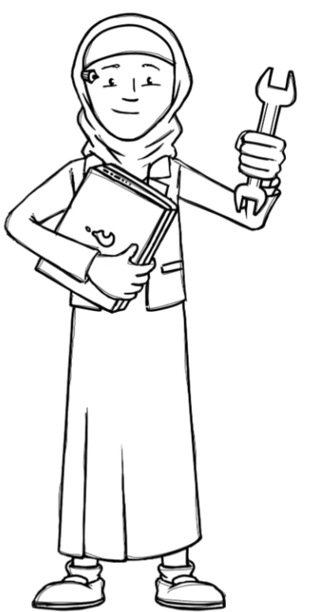
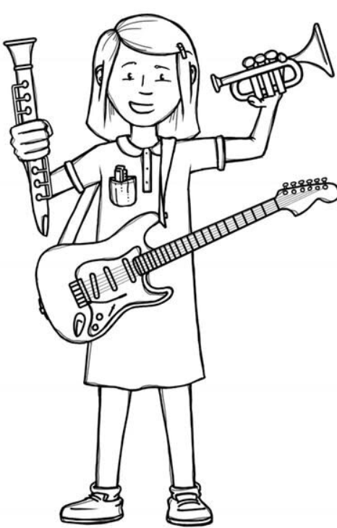
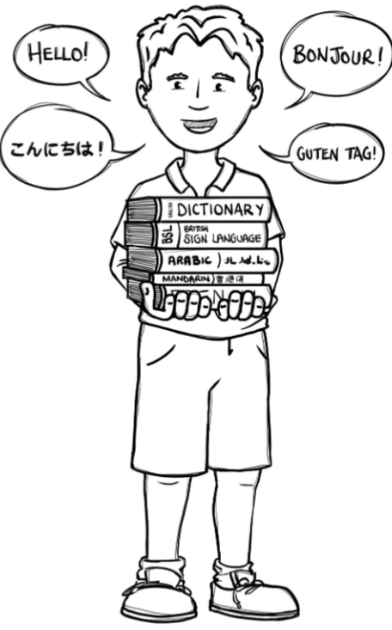
Hedgehogs Class Curriculum Overview—Spring 2
Enquiry: What stories do we know?
Being Mathematicians
Being Scientists
We will be using our knowledge of mathematics to show what we know about numbers, counting and understanding amounts working within 10
and extending to 20.
We will be sharing our favourite books and stories and finding out what stories other people like too. There will be opportunities for adults to come and read to us and for us to re-tell stories with other children too. We will make story baskets to share.
Being Authors and Readers
We will be finding out about how our school changes in the Spring.
As part of our enquiry we will be
finding out about how plants grow.
Being Historians and Geographers
We will be sharing stories that are old favourites or ones our mummies and daddies used to like when they were young. We will talk about why some stories are very old and why we still love them today.
Being Philosophers
Being Athletes
Taking part in class PE sessions focusing on games and visiting sports coaches learning invasion and tagging games.
We will be learning about responsibility and what it means. We will also be sharing the Easter story.
Being computer scientists
Being Artists and Engineers
Being a Musician
Exploring logging on in the computer room and using Numbots.
Being Linguists
We will be making and illustrating our own books and stories.
Exploring a variety of musical instruments.
Joining in with singing and rhyming.

