Slide 1
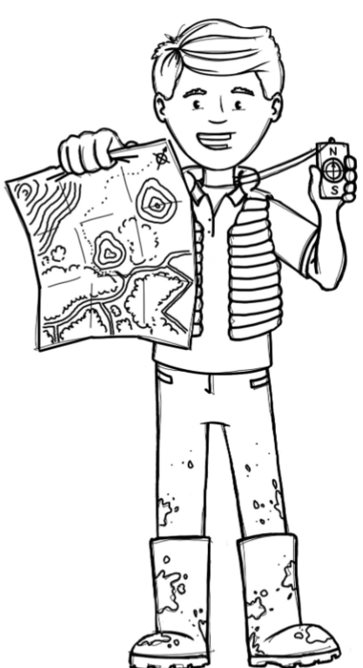
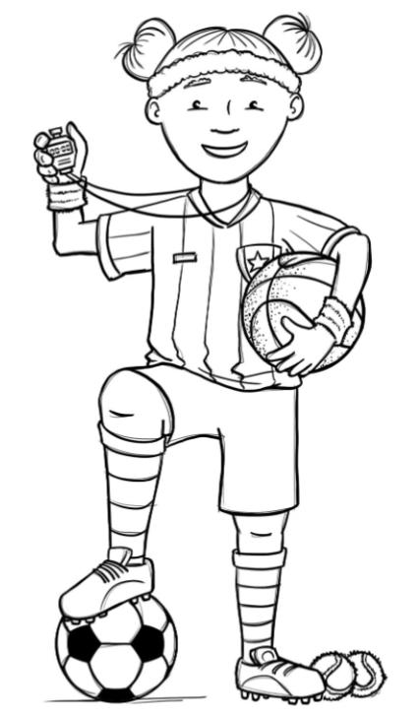
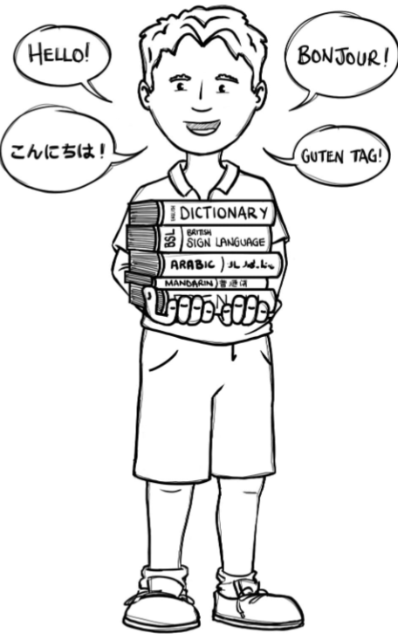
Hedgehogs Class Curriculum Overview—Summer 1
Enquiry: Where can we go?
Being Mathematicians
Being Scientists
We will be using our knowledge of mathematics to show what we know about numbers, counting and understanding doubles and composition of numbers within 20 and beyond.
We will be reading stories and non-fiction books about visiting the seaside. We will use non-fiction books to find out what is needed for our ‘expedition kit’ for a beach trip. We will be writing our own kit lists so we know what to take.
Being Authors and Readers
We will be finding out how our school changes in Summer. We will be looking at planting in the outdoor area.
Being Historians and Geographers
We will be receiving a special letter inviting us to go to the beach. We will use maps to locate the place we are going. We will look at different vehicles, comparing those today with ones from the past and decide how we should travel to the beach.
Being Philosophers
Being Athletes
Taking part in class PE sessions in class and with the visiting sports coaches learning athletics skills we will need for Sports Day!
We will be learning about looking after ourselves and being healthy. In RE we will be thinking about what makes us special.
Being computer scientists
Being Artists and Engineers
Being a Musician
Exploring logging on in the computer room and using Numbots.
Being Linguists
We will be making pictures of the seaside and junk modelled vehicles.
Exploring a variety of musical instruments.
Joining in with singing and rhyming.

