Slide 1
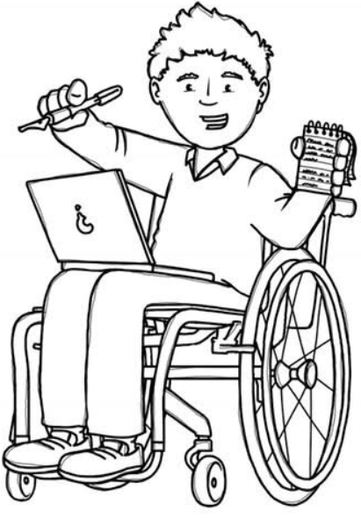
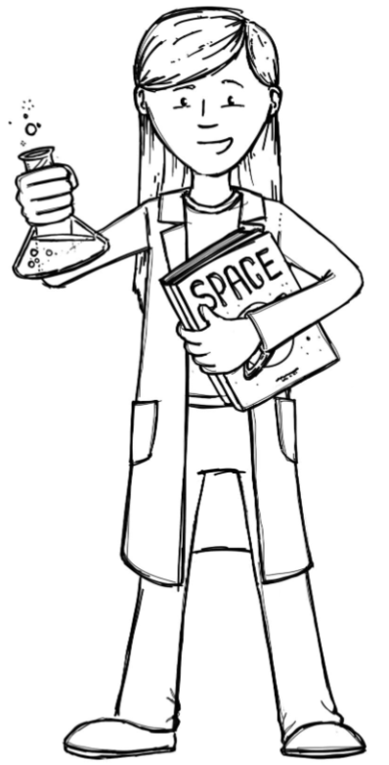
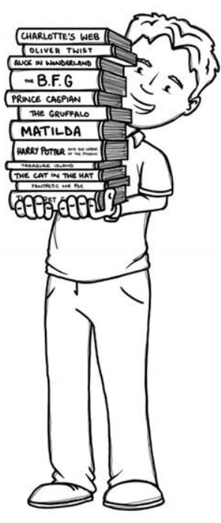
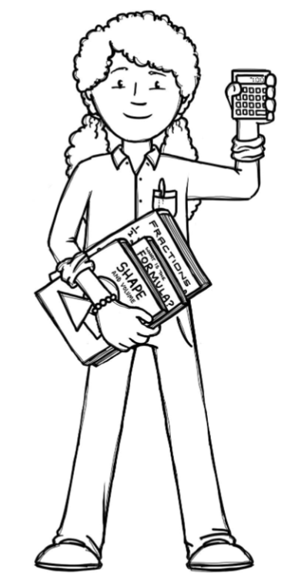
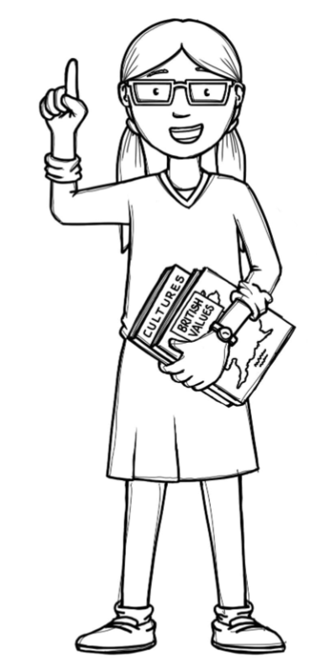
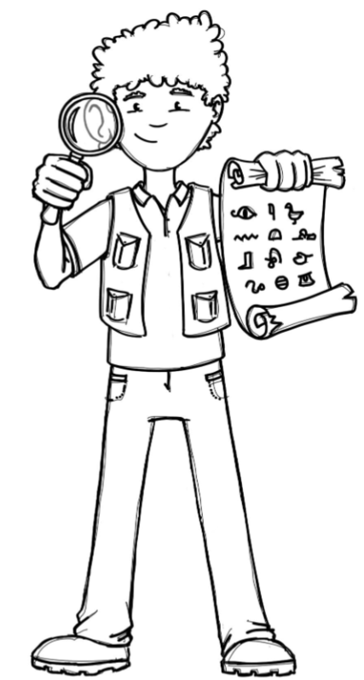
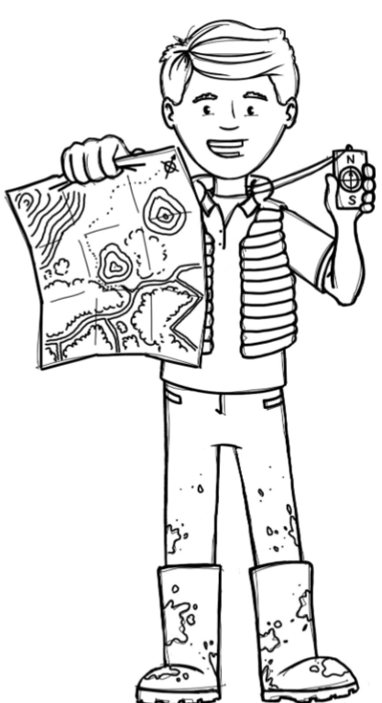
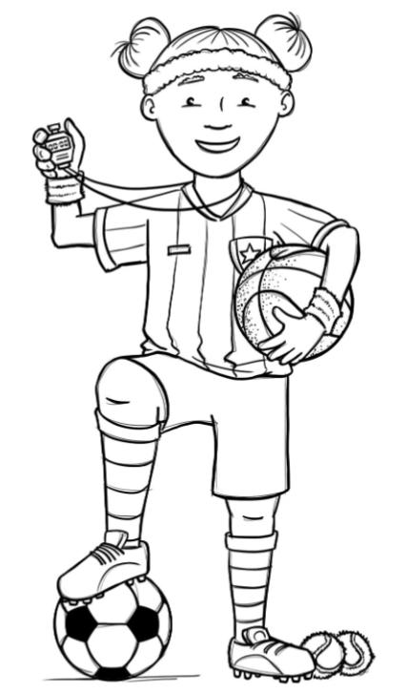
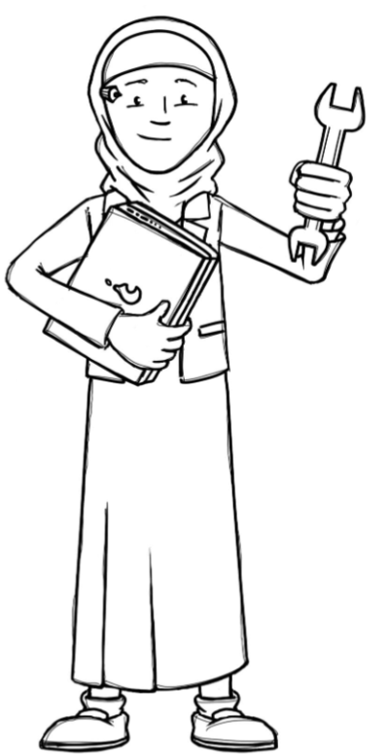
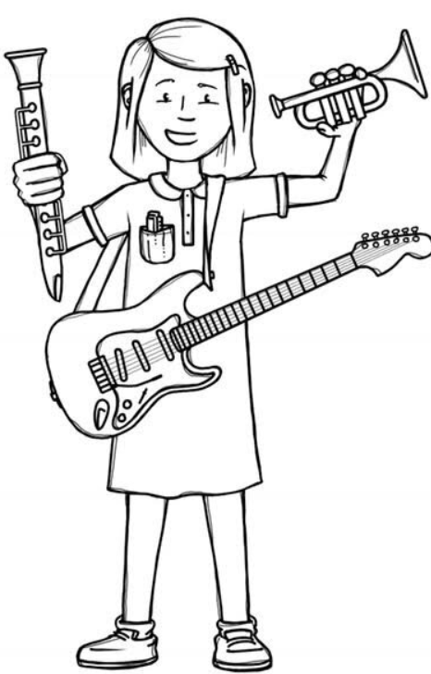
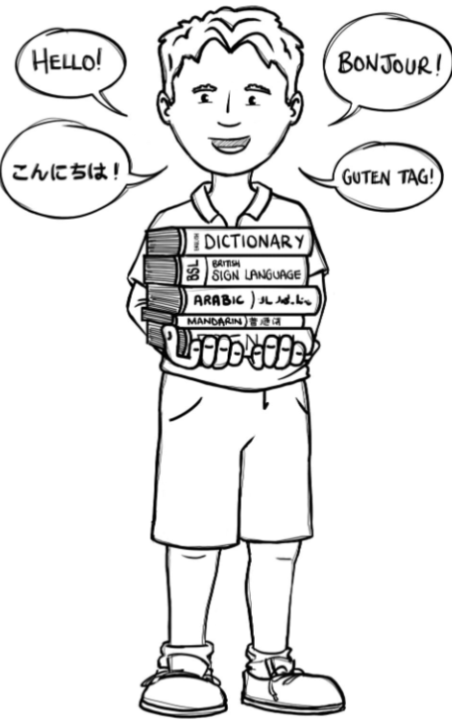
Hedgehogs Class Curriculum Overview—Summer 2
Enquiry: Where does food come from?
Being Mathematicians
Being Scientists
We will be using our knowledge of mathematics to show what we know about numbers, counting and understanding doubles and composition of numbers within 20 and beyond.
We will be reading stories and non-fiction books about food and farming. We will use non-fiction books to find out about farms and how different food is produced. We will be writing our own recipes and following them to bake exciting things!
Being Authors and Readers
We will be finding out the differences between humans and animals. We will be investigating farm animals and minibeasts, using scientific knowledge to make observations.
Being Historians and Geographers
We will be discussing how farming machinery has changed over the years. We will think about the impact on the environment and what effect organic farming has on the countryside we live in.
Being Philosophers
Being Athletes
Taking part in class PE sessions in class and with the visiting sports coaches learning athletics skills we will need for Sports Day!
We will be learning about looking after ourselves and being healthy. In RE we will be thinking about what makes us special.
Being computer scientists
Being Artists and Engineers
Being a Musician
Exploring logging on in the computer room and using Numbots.
Being Linguists
We will be making junk modelled tractors and farm animal pictures.
Exploring a variety of musical instruments.
Joining in with singing and rhyming.

