Slide 1
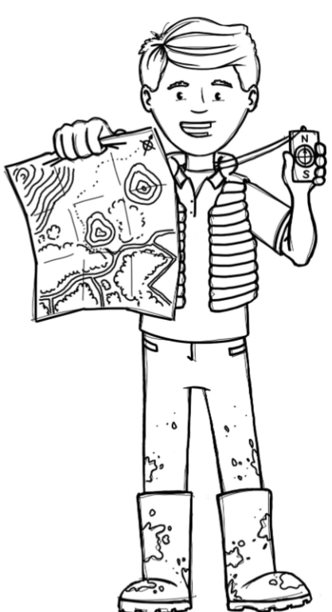
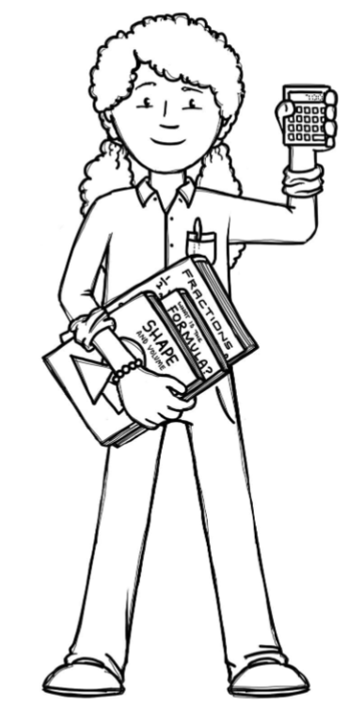
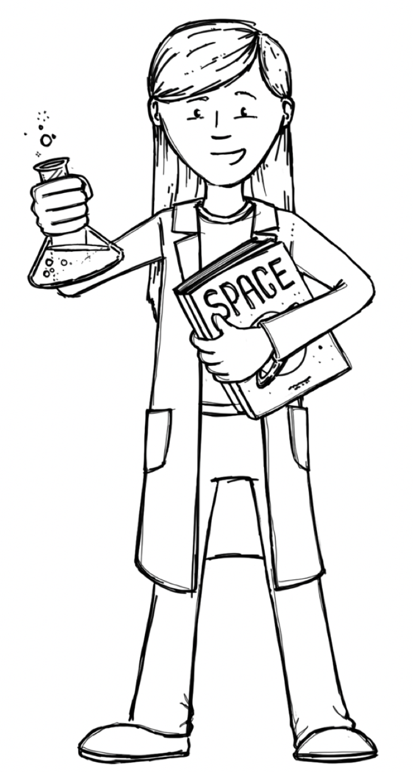
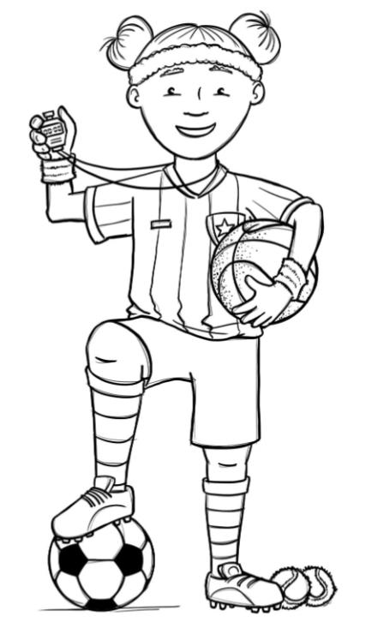
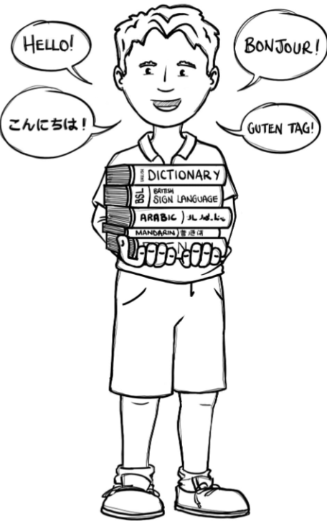
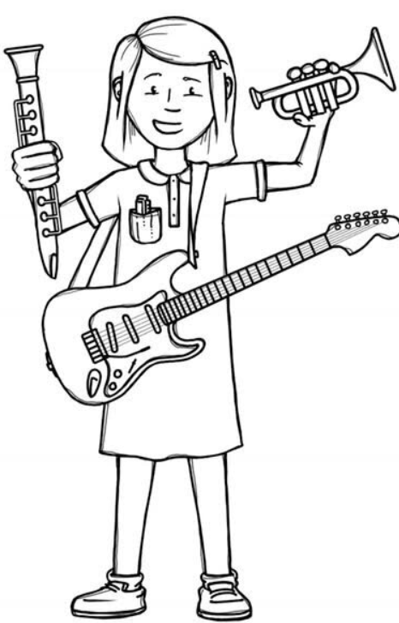
Badgers Class Curriculum Overview—Spring 1
Enquiry : What is underneath our feet?
Being Mathematicians
Being Authors and Readers
Being Geographers
Reading for Pleasure – Little Badman and the
Invasion of the Killer Aunties
Narrative: Library Lion
Non-Chronological report – The Street Beneath My Feet
Grammar – Use expanded noun phrases. Identify pronouns and use them in writing. Use adverbs and adverbials to add detail to a verb. Year 4 also use future tense consistently throughout a piece of writing. Maintain an accurate tense throughout a piece of writing. Use metaphors in writing.
Punctuation – Use apostrophes for contractions and possession. Year 4 also use all of the necessary punctuation for direct speech. Use apostrophes for plurals. Use apostrophes for it’s and its correctly.
Composition – Begin to organise writing into paragraphs around a theme. Compose and rehearse sentences orally. Draft, redraft and edit their writing, increasing accuracy and to make improvements. Year 4 also use bullet points, headings, subheadings and columns if appropriate.
Mini Questions covered within enquiry:
What do we know about physical and human features?
What are the key features of a volcano?
What are the key features of an earthquake?
Where in the world in the Ring of Fire?
What is it like to live near a volcano/earthquake zone?
Multiplication and Division:
- Factor pairs
- Multiply and divide by 10,100
- Multiply 3 numbers
-Multiply & divide up to 3-digit numbers by a 1-digit number
Area:
-Find the area of a shape
-Comparing area
Mass & Capacity:
-Measuring mass in kg & g
- Measuring capacity in l & ml
Being Scientists
Mini Questions covered within enquiry:
How can we group rocks together?
How are fossils formed?
What is soil made from?
Challenge – Create a flowchart and video message for the professor explain how rocks and soil are formed.
Being Athletes
-
Invasion games – Dodgeball
Fitness – Dance
Being Philosophers
Being computer scientists
Being a Musician
Computer Programming using Scratch
-To identify objects as Sprites
To program sprites using blocks of commands
- Islam -How does a Muslim show their submission and obedience to Allah?
- Stormbreak/PSHE – Self-care/keeping myself safe
Being Linguists
- Use and understand musical
notations.
- Listen with attention to
detail and recall sounds
with increasing aural memory.
- Vegetables
Notes:
1

