Slide 1
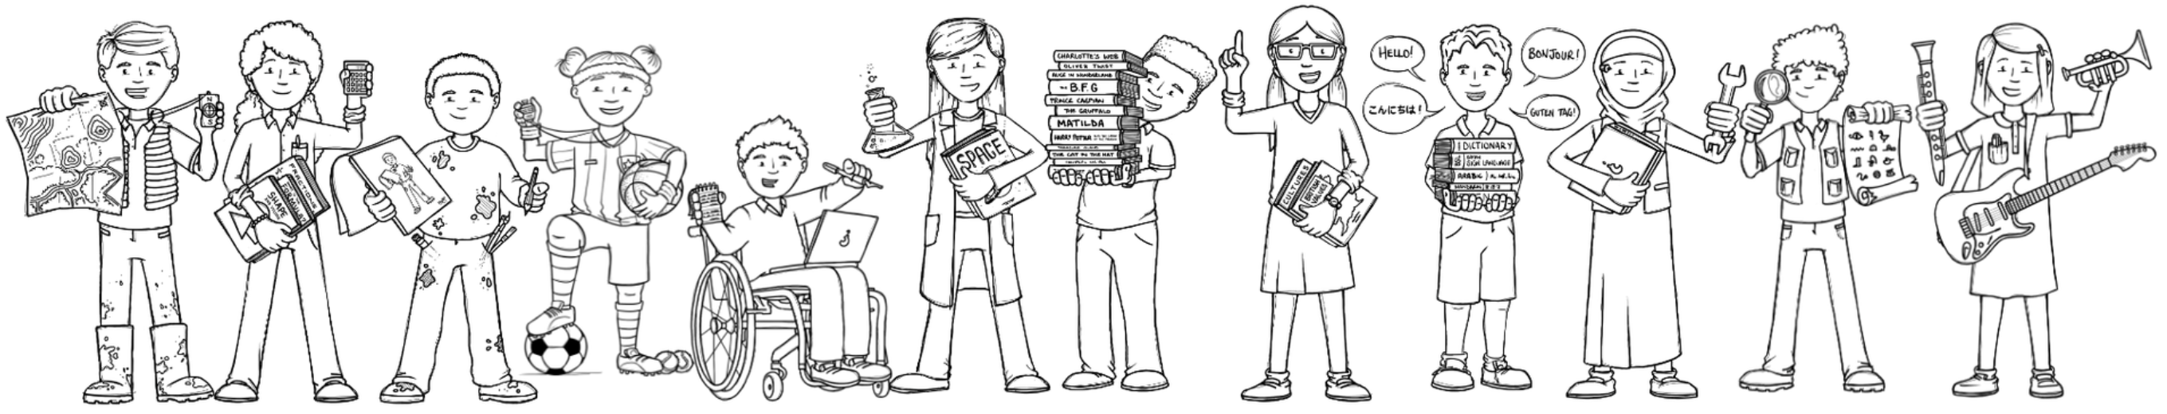
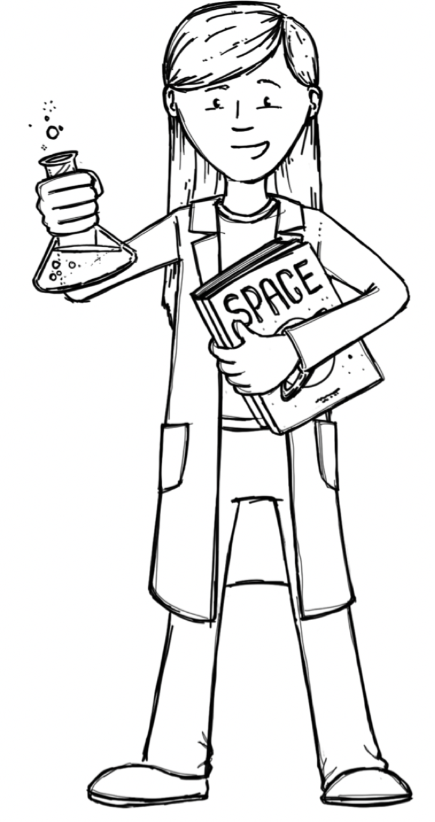


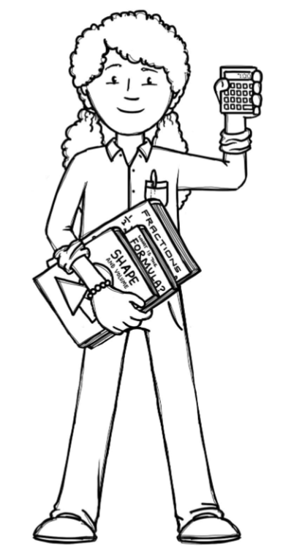
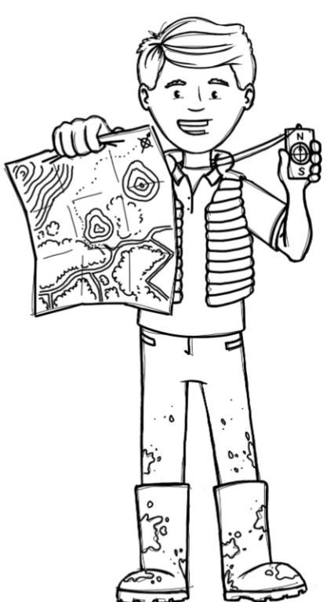

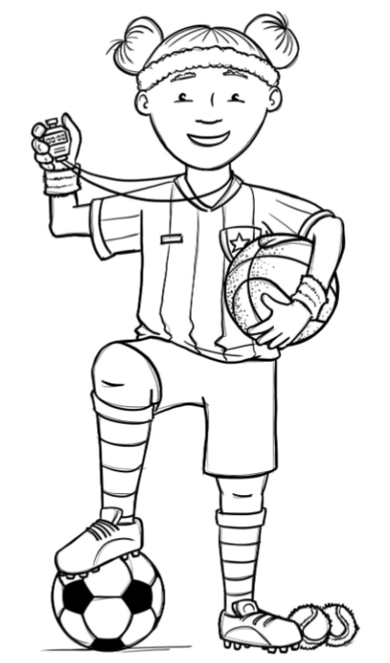
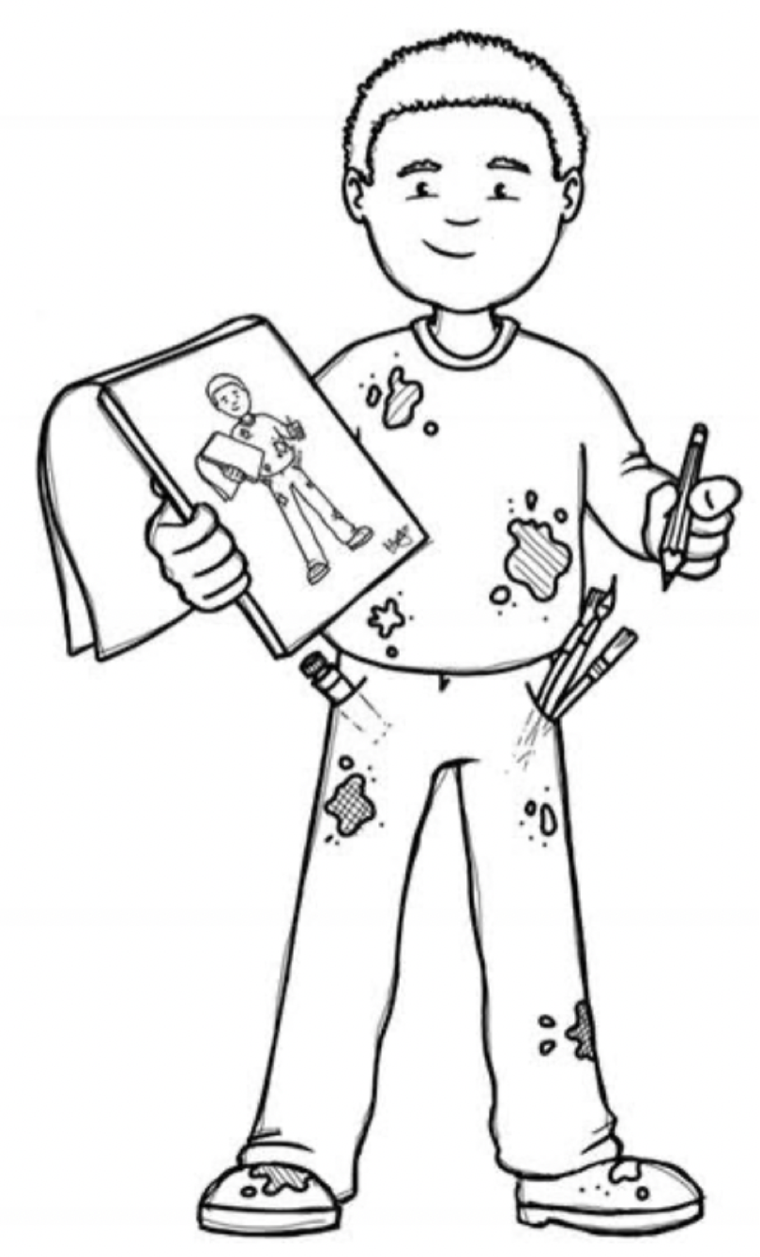

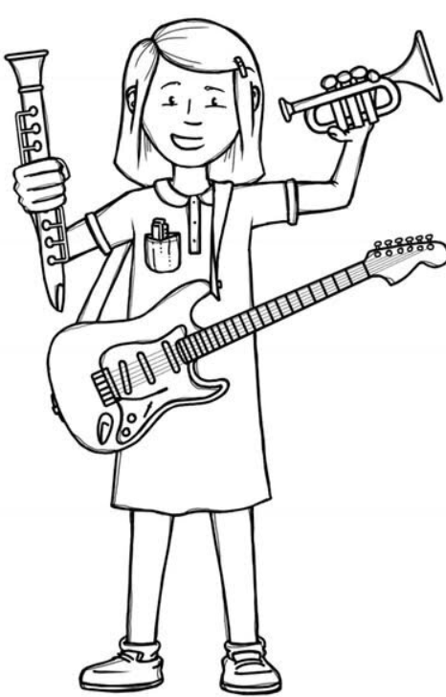
Badgers Class Curriculum Overview—Summer 1
Enquiry : How do plants die?
Being Mathematicians
Being Authors and Readers
Being Scientists:
Reading for Pleasure – Podkin One Ear
Narrative: The Boy, The Mole, The Fox and The Horse
Explanation Text –How a Robot Dog Works
Grammar – Spring learning plus using adverbs and adverbials to detail when, why, how and where a verb happened and punctuate correctly. Recognise metaphors. Year 4 also consolidate all previous learning and use standard English inflections accurately e.g ‘We were’ rather then ‘We was’.
Punctuation –Spring learning plus using a comma after simple fronted adverbials. Year 4 also revisit and consolidate all previous learning.
Composition – Draft, redraft and edit their writing with increasing accuracy to make improvements.
What plants do we know? Recap of KS1 learning.
What are the functions of different parts of the plant?
-Identify and describe the functions of different parts of flowering plants: roots, stem/trunk, leaves and flowers.
How do plants live and grow?
-Explore the requirements of plants for life and growth (air, light, water, nutrients from soil and room to grow) and how they can vary from plant to plant.
How is water transported in plants? (Investigation)
-Investigate the ways in which water is transported within plants.
What is the role of the flower?
-Explore the part that flowers play in the life cycle of flowering plants, including pollination, seed formation and seed dispersal.
Fractions
-Compare & order
-Understand the whole
-Add & subtract fractions
-Mixed numbers & improper fractions
Shape
-Turns & angles
-Identify angles
-Types of lines & triangles
Being Philosophers
Being Geographers
Christianity – What do Christians mean when they talk about the Kingdom of God?
Being my Best
Can all plants live everywhere?
Vegetation belts/Climate zones
Location of equator, North and South Pole and Tropics
Being Athletes
Being Artists
Cricket & Swimming/Athletics
Being a Musician
Being Computer Scientists
Being Linguists
Who was Marianne North?
-Learn about great artist, architects and designers in history.
How can we draw details of plants?
-Improve their mastery of art and design techniques including drawing.
Exploring Feelings When You Play
Creating Media
Desktop Publishing
My Family
Notes:
1

