Slide 1
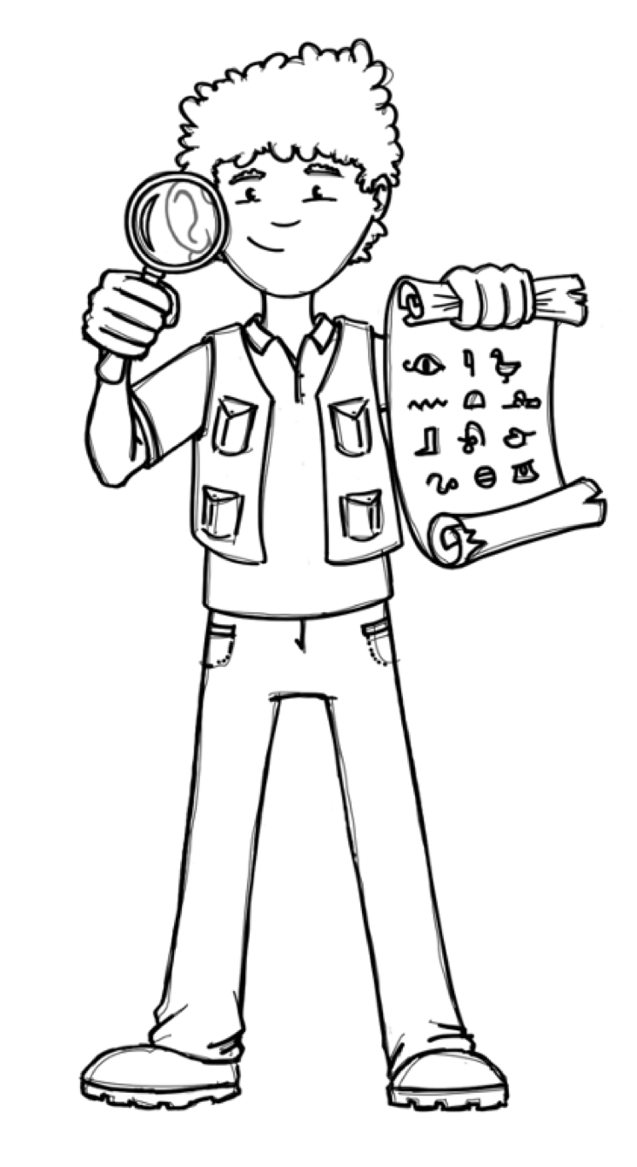
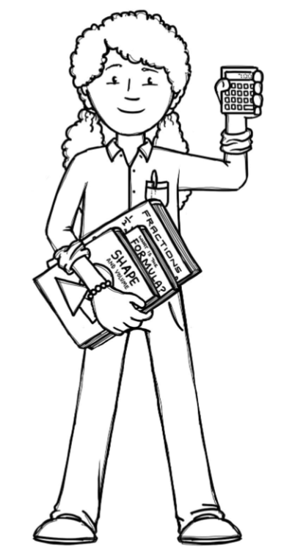
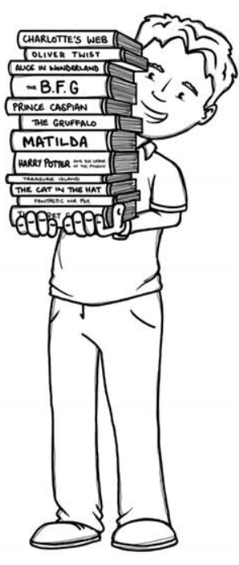
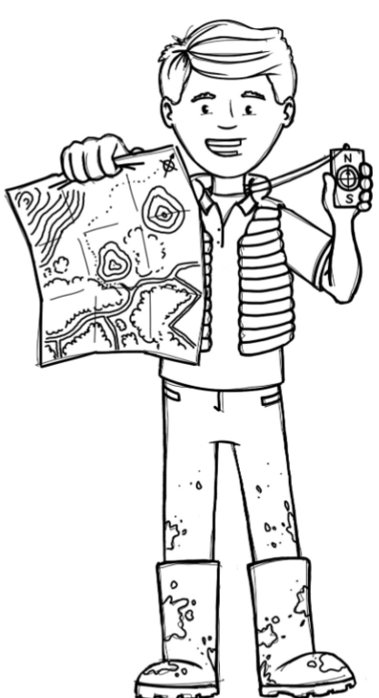
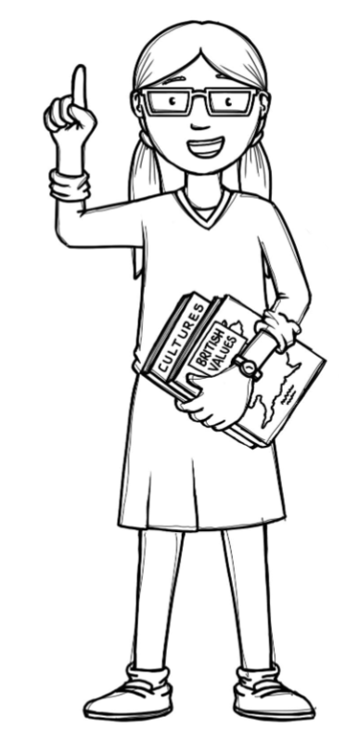
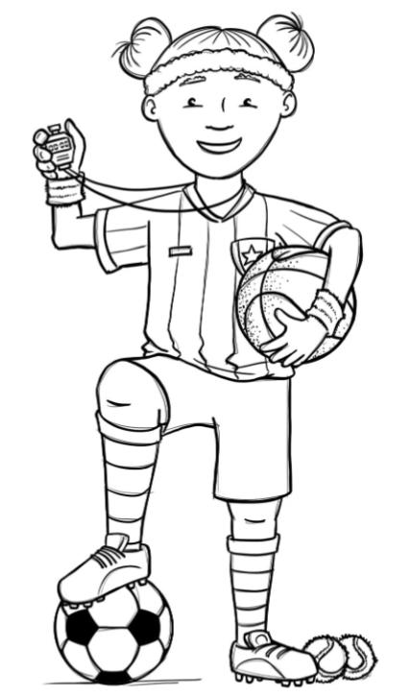
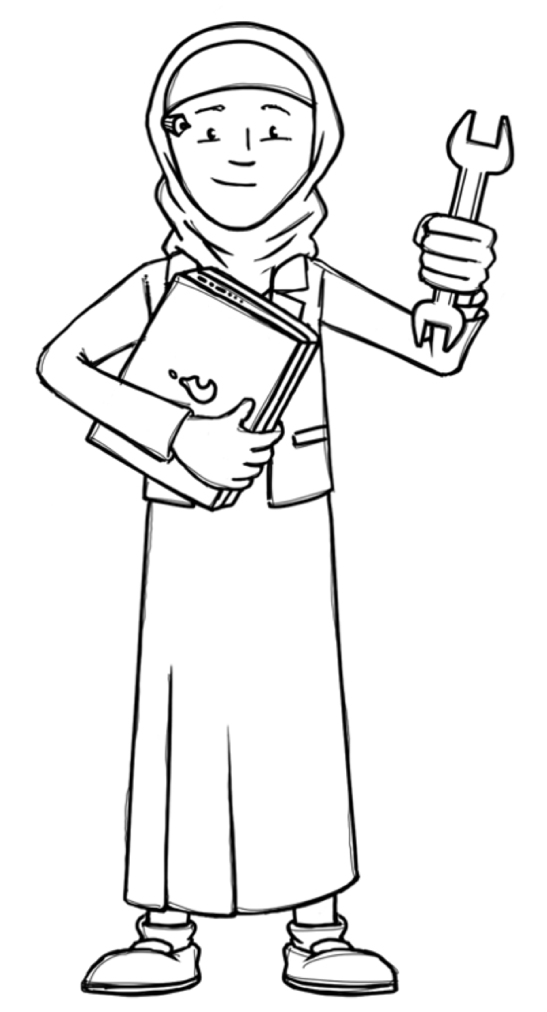
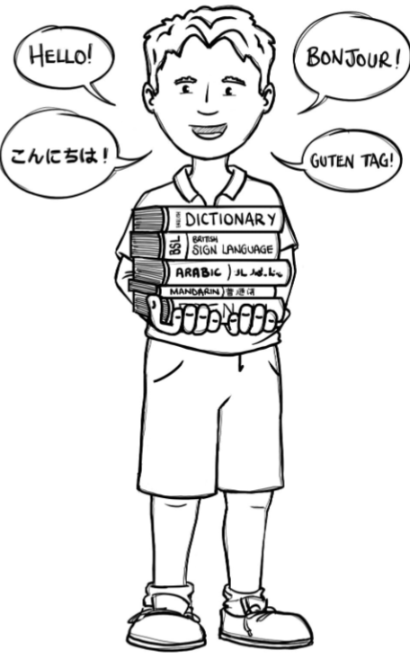
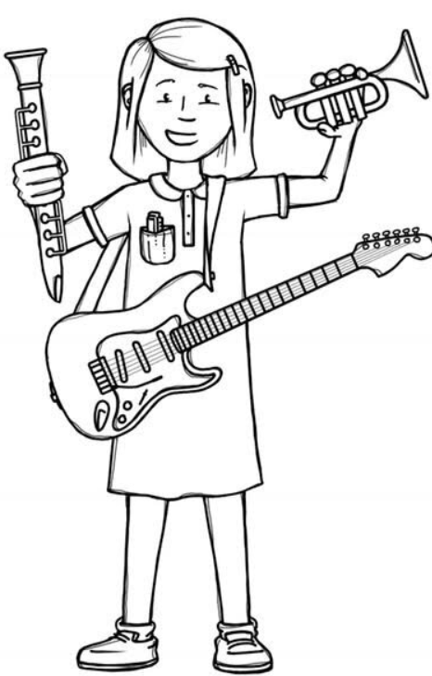
Badgers Class Curriculum Overview—Summer 2
Enquiry : Why did people travel in the past?
Being Mathematicians
Being Authors and Readers
Being Historians
Shape:
-Turns & angles
-Identify angles
-Types of lines & triangles
Money:
-Write money as decimals
-Convert pounds to pence
-Find change
Decimals:
-Tenths and hundredths as decimals
-Compare and order
-Round to the nearest whole number
Time
Reading for Pleasure – The Wild Robot
Narrative: The Iron Man
Balanced Argument: Should we feed animals in national parks?
Poetry: The Colour Collector
Grammar – Recognise and use metaphors. Revisit and consolidate all previous learning.
Punctuation – Use a comma after simple and more complex fronted adverbials. Begin to demark subordinate clauses. Revisit and consolidate all previous learning.
Composition – Draft, redraft and edit their writing with increasing accuracy and to make improvements. Continue to work on using bullet points, headings and subheadings if appropriate.
-Why do people travel today?
-What reasons did people have to travel in the past and how do we know?
-What was travel like in the early 1900s and what made
the Titanic so significant?
-Who was…? Case study of passengers on the Titanic from different classes.
-How do we know about people who travelled on the Titanic.
Being Geographers
-Revisit continents, oceans, North/South Pole, Northern/ Southern Hemisphere, Equator, Tropics and Arctic/ Antarctic Circle.
-Name and locate the counties that make up South West England
-Know and name the 8 points of a compass.
-Use maps to locate cities and countries involved in
the story of the Titanic.
Being Philosophers
Judaism - What symbols and stories help Jewish people remember
their covenant with God?
PSHE - Growing & Changing
Being Athletes
Being Engineers
Swimming/Tennis
Being Musicians
-Choose from a variety of materials and components, including textiles, to a flag.
-Start to measure, tape or pin, cut and join fabric with some accuracy.
-Use simple sewing techniques including cutting, shaping and joining fabric to make a simple product.
Being Computer Scientists
Being Linguists
Understand music & improvise together
Events & actions in Programs - explain how a sprite moves in an existing project (Using Scratch)
In the classroom
Notes:
1

