Slide 1
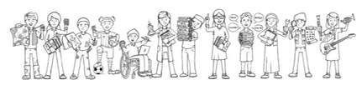
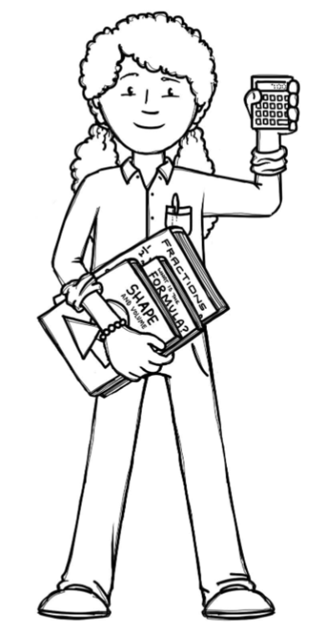
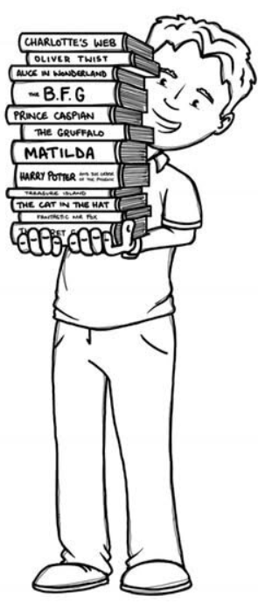
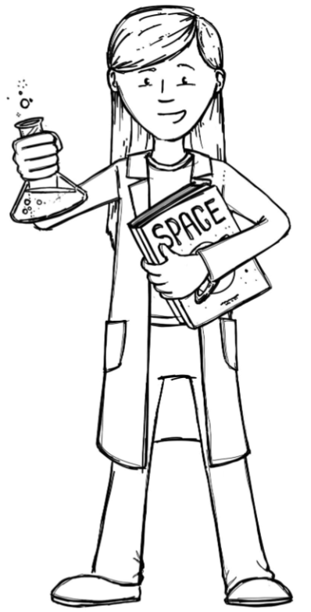
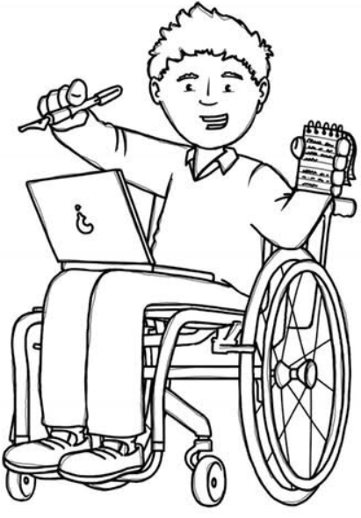
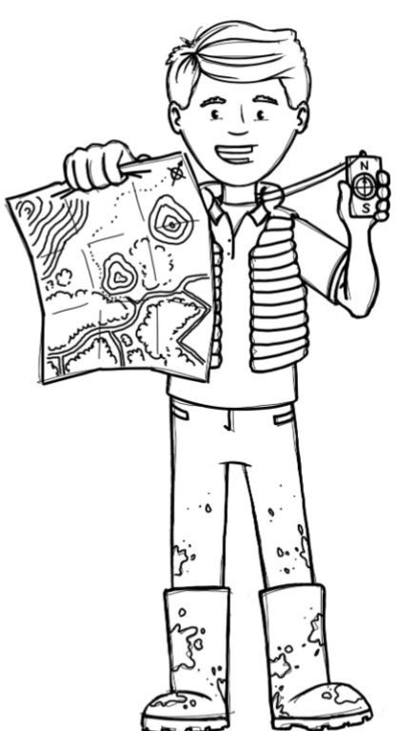

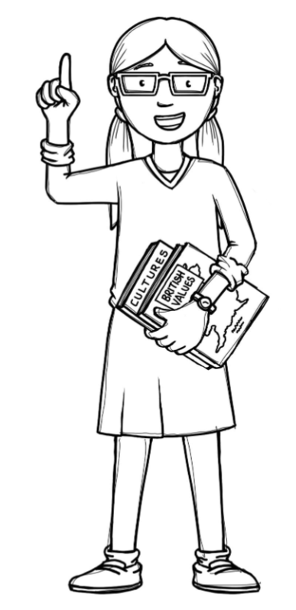
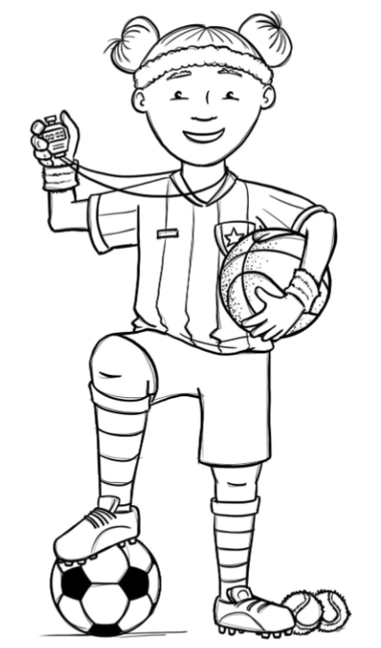
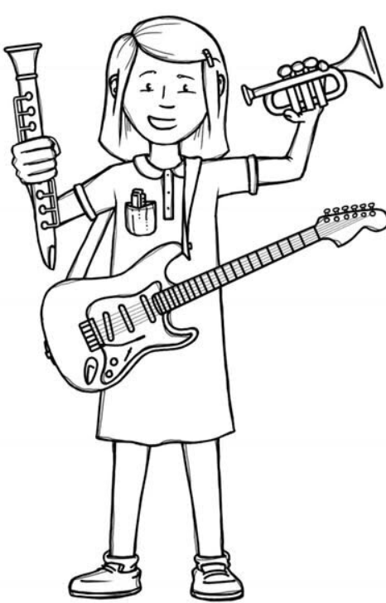
Squirrels Class Curriculum Overview—Autumn 1
Enquiry 1: What do Artists do? Enquiry 2: How does my school change in Autumn?
Being Mathematicians
Being Authors and Readers
Being Scientists
We will be observing and describing the changes
that happen in season of Autumn, including the
Weather. We will gather and record data to help in answering questions.
We will be understanding the Place value of a number up to 20 and practising using addition and subtraction strategies effectively.
We will continue to improve our phonics and reading with Read Write Inc. As Writers, we will be going on Curious Quests where we will meet and help new faithful friends. We will be writing a narrative, a fact file and instructions while promoting correct letter formation, good sentence punctuation.
Being Geographers
We will begin to identify seasonal and
daily weather patterns in the UK.
Being Philosophers
We will be asking the question 'Why is belonging to God and the church
family important to Christians?'
As well as, looking at Me and my Relationships through SCARF.
Being Artists
We will use drawing and painting
to develop and share our ideas.​
We will begin to develop techniques using colour, pattern, texture, line, shape, form​ and space.​
We will find out about the work of a range​ of artists​ and making links to our own work.
Being Athletes
Being a Musician
We will be developing our
gymnastic skills on Tuesdays
and our Tag Rugby multi skills on Thursdays. Forest School is on Wednesdays.
Being computer scientists
We will be developing
our listening, singing
and composing
skills using
Charanga.
We will look at On-line Safety and Technology outside school.

