Slide 1
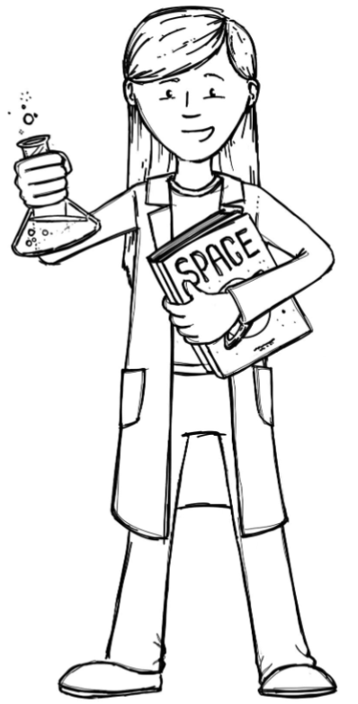
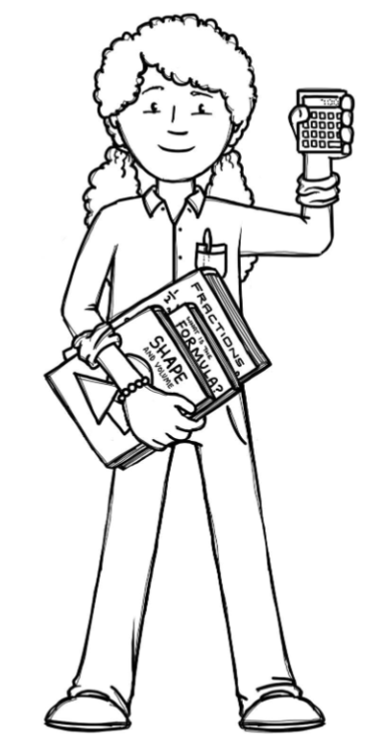
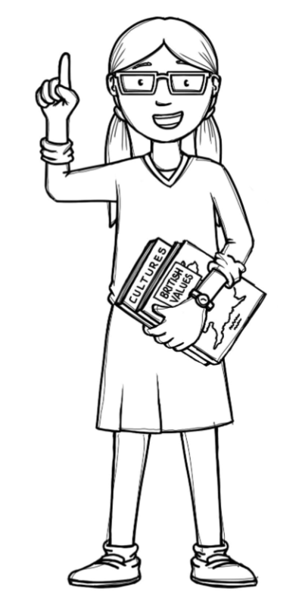
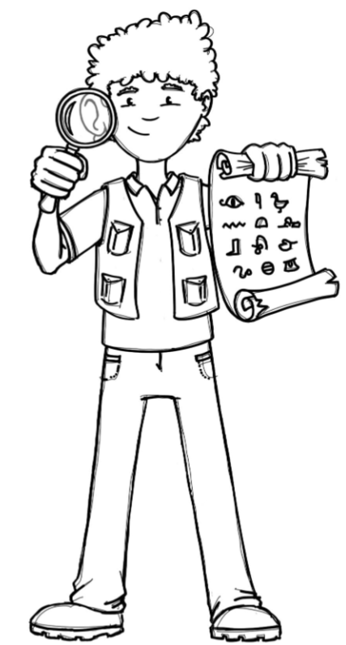
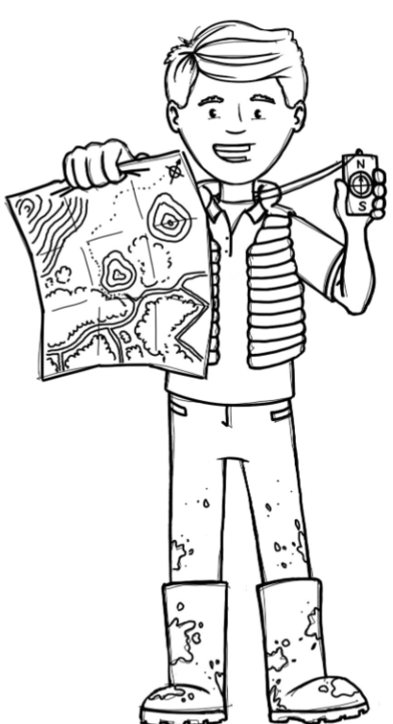
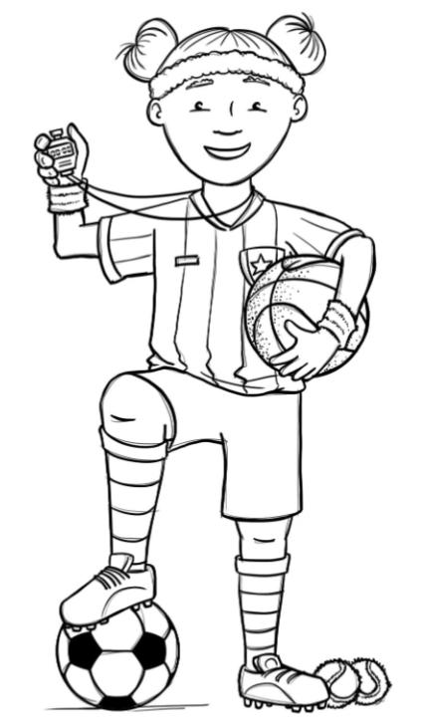
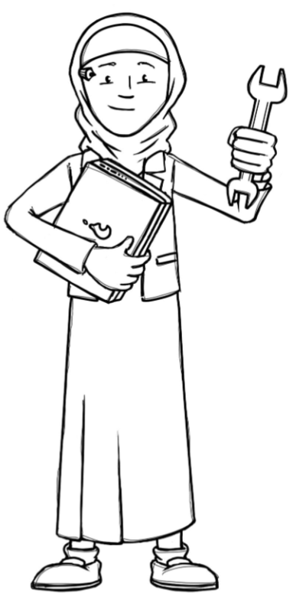
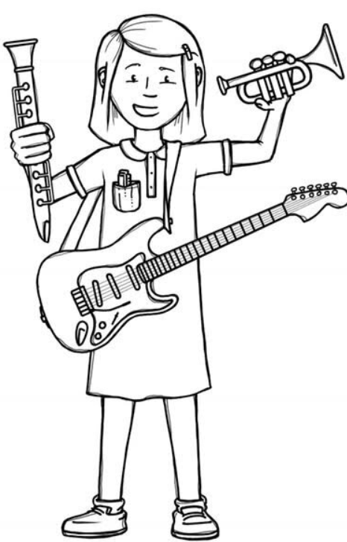
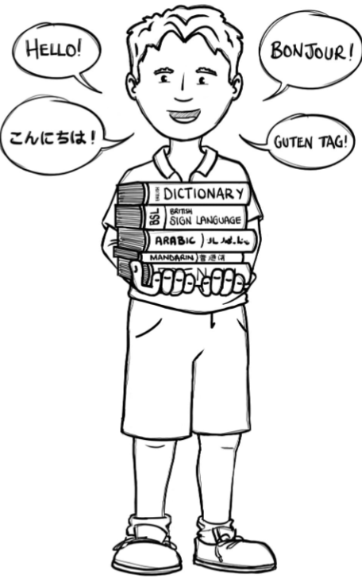
Foxes Class Curriculum Overview—Spring 1
Enquiry 3: How can science help the vulnerable?
Being Mathematicians
Yr 5 – Fractions, Decimals and Percentages.
Yr 6 – Ratio, Algebra, Fractions, Decimals and Percentages
Being Authors and Readers
Being Scientists
The Arrival - narrative
Beegu – narrative with speech
Boy at the back of the class – discussion
Comprehension crushers – Refugees
Comprehension crushers – Geography and Mexico
Piers Torday
Properties and changes of materials
Being Historians and Geographers
Being Philosophers
Being Athletes
EMMANUEL
Hinduism – What spiritual pathways to Moksha are written about in scriptures?
Y5/Y6 CORAM SCARF
Keeping Safe
Dodgeball – Led by Prime sports
Dance – Led by Teacher
Being Artists and Engineers
Being computer scientists
Being a Musician
Being Linguists
Design and produce a product to help the vulnerable
Charanga:
Exploring Key and Time Signatures
TEACH COMPUTING
Programming A – selection in physical computing
What is the weather?

