Slide 1
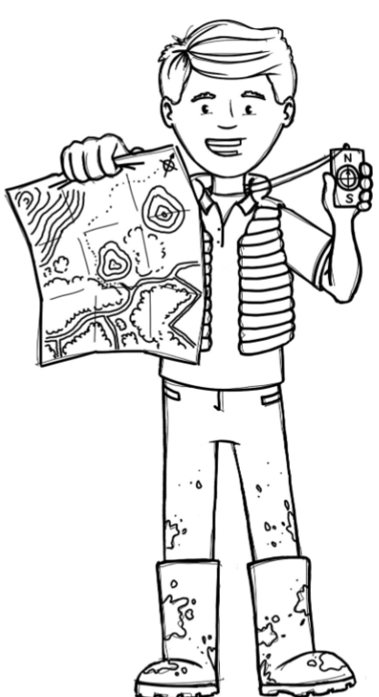
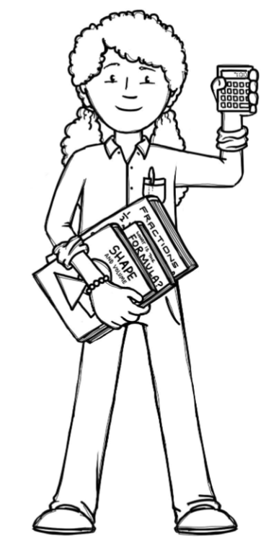
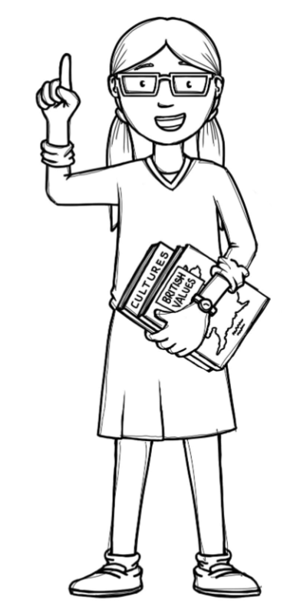
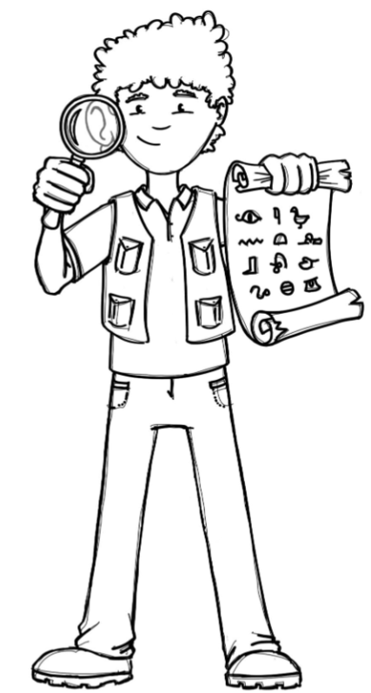
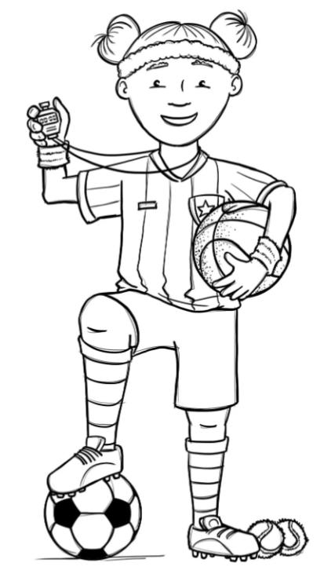
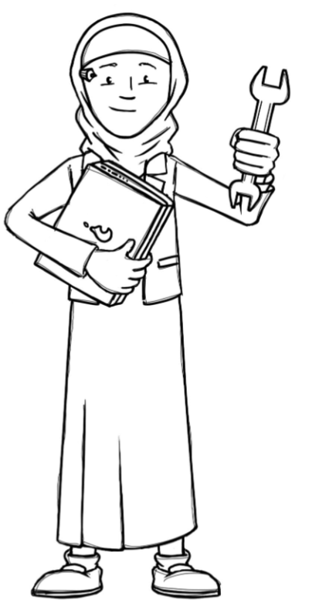
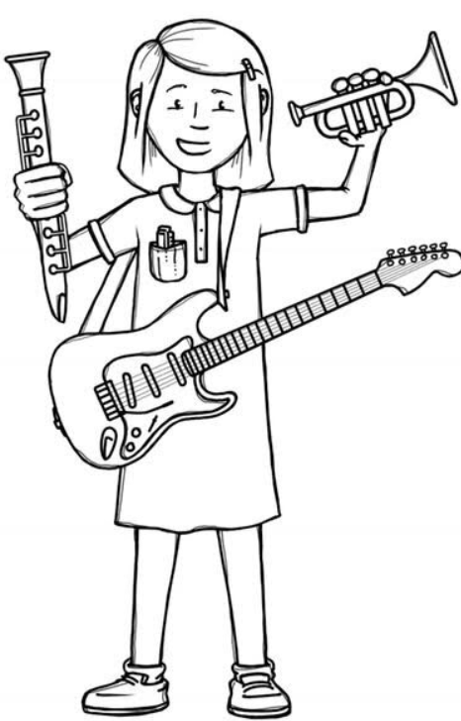
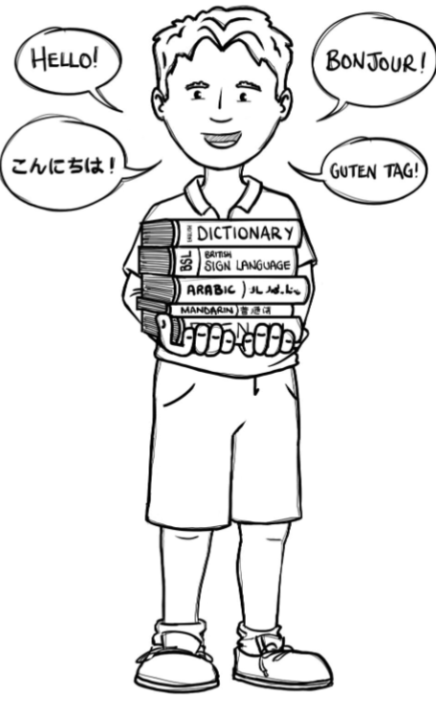
Foxes Class Curriculum Overview—Spring 2
Enquiry 4:Who is trading with whom?
Being Mathematicians
Fractions, Decimals and Percentages
Decimals
Converting Units
Shape
Being Authors and Readers
Being Geographers
Being Authors
Dreadful Menace - Poetry
How to be a Lion
Rome wasn’t built in a day – Diary writing
Screen or no screen? – balanced argument
Being Author Readers
Chromatography
Heston’s craziest recipes
Comprehension Crushers – A Gunners day and the little smuggler
Spurting science
Ravens day 1, 2 and 3
Comprehension crushers – Caesar and Ferrers
Mini questions within our enquiry
What is trade?
What makes a good location for trade?
What is trade?
Being Historians
Mini questions within our enquiry
Who were the Romans and how did they build their empire?
What evidence is there that the Romans settled in Britain?
How do we know the Romans traded in Britain?
Being Philosophers
Being Athletes
EMMANUEL – Judaism
What is holiness for Jewish people; a place, a time, an object or something else?
Basketball – Led by Prime sports
Yoga– Led by Teacher
Being computer scientists
Being Engineers
Being a Musician
Being Linguists
Charanga: Music and technology
TEACH COMPUTING
Programming A – creating media – introduction to vector graphics
My Home
Mini questions within our enquiry
What is currency and what could it be made from?
How is currency designed?

