Slide 1
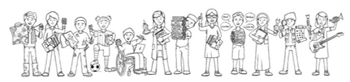

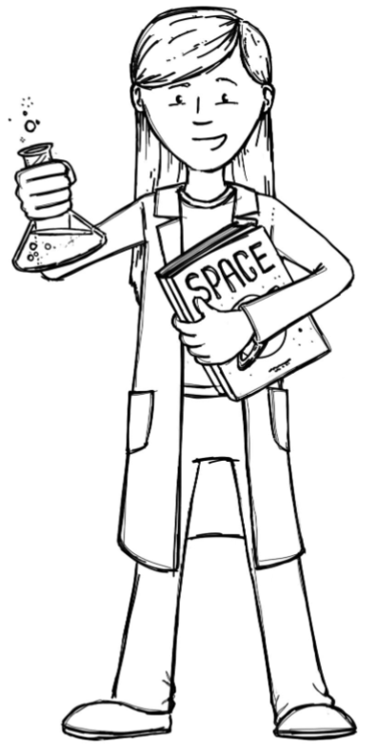
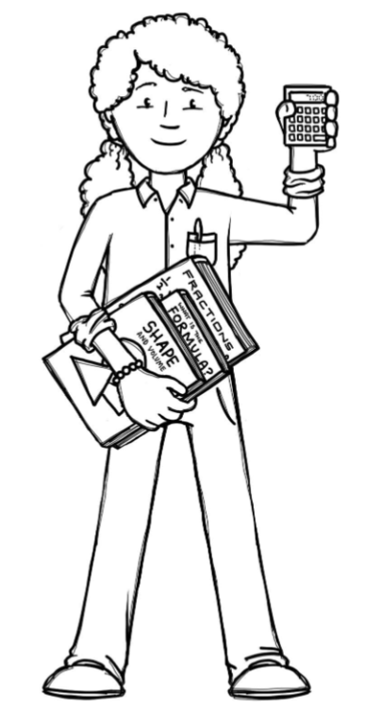
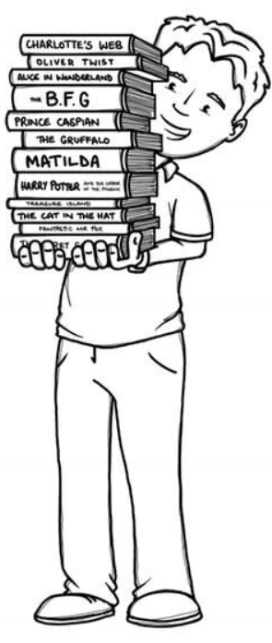
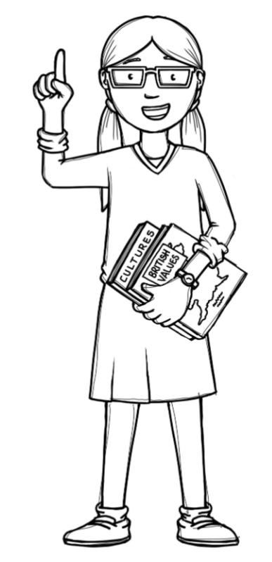
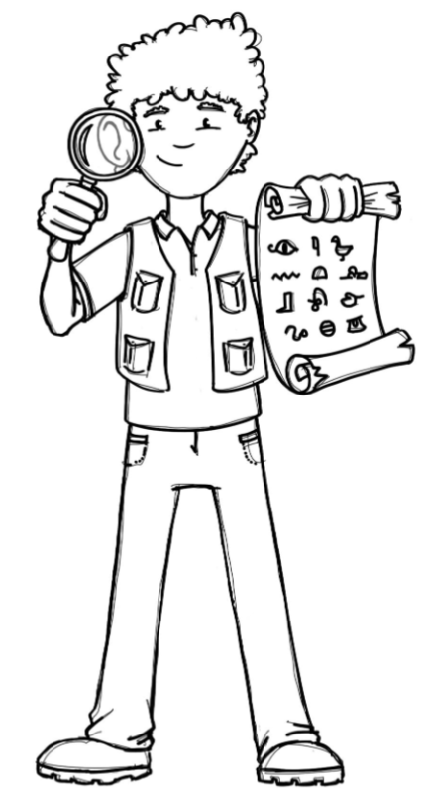
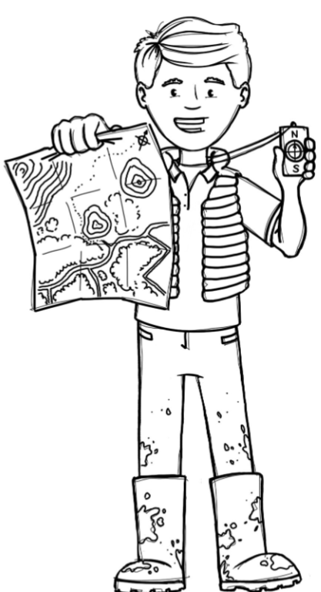
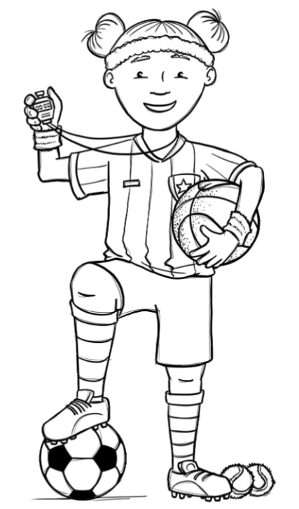
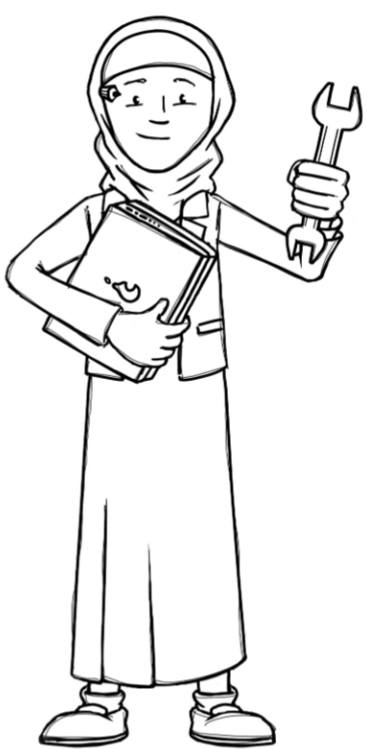
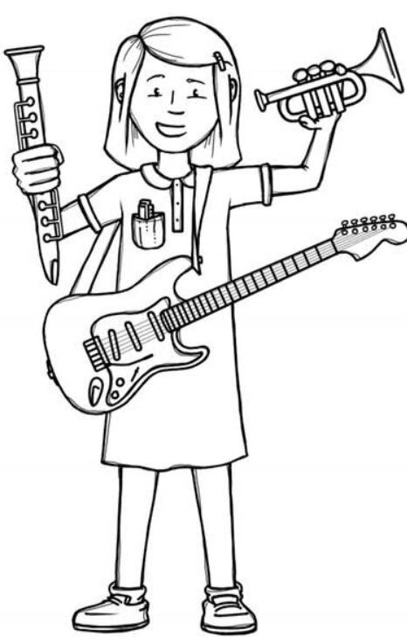
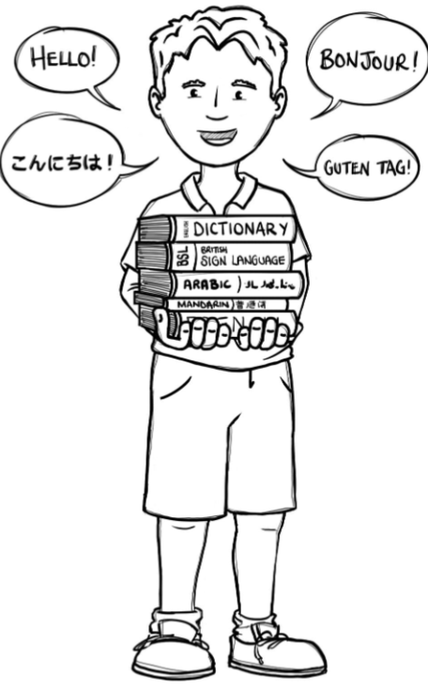
Hedgehogs Class Curriculum Overview—Spring 1
Enquiry: What could my den be made of?
Being Mathematicians
Being Scientists
We will be using our knowledge of mathematics to show what we know about numbers, counting and understanding amounts working within 10
and extending to 20.
Being Authors and Readers
We will be finding out about how our school changes from Winter to Spring.
As part of our enquiry we will be
finding out about different materials and their properties.
We will be practising our phonic knowledge to write words we know and begin to form sentences using capital letters and full stops. We will be looking at the traditional tale ‘The Three Pigs’ and other stories including themes about construction.
Being Historians and Geographers
We will be looking at the history of buildings in the local area and finding out what the materials used to build them were. We will look at how building materials have changed over time and why some methods are still used today
Being Philosophers
Being Athletes
Taking part in class PE sessions focusing on dance and visiting sports coaches learning football skills.
We will be talking about friendships and how to look after ourselves and each other.
Being computer scientists
Being Artists and Engineers
Being a Musician
Exploring logging on in the computer room.
Being Linguists
We will be using our artistic and engineering skills to create our own den.
Exploring a variety of musical instruments.
Joining in with singing and rhyming.

