Slide 1
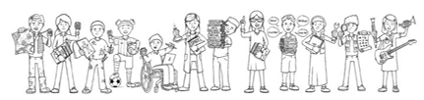

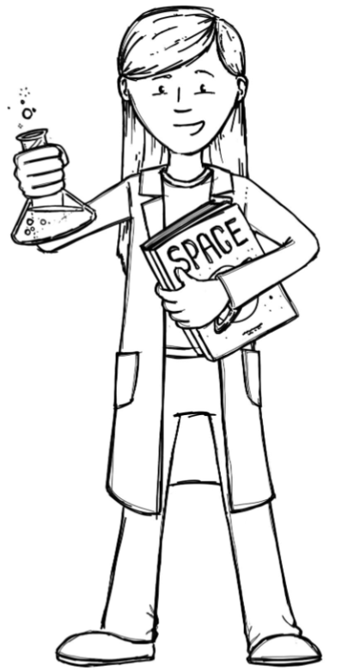
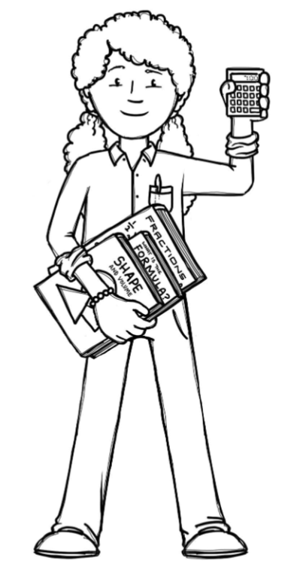
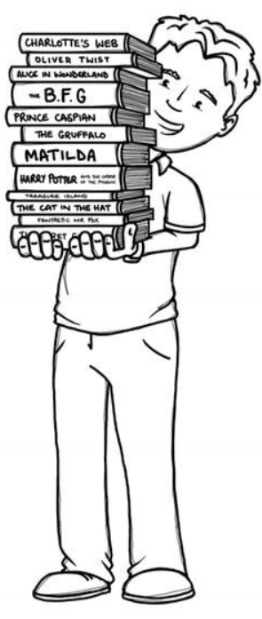
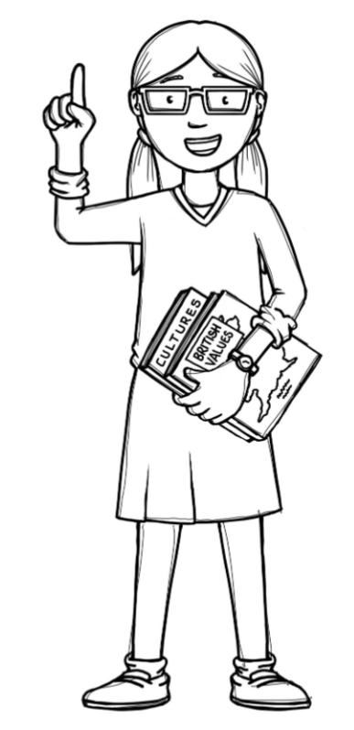
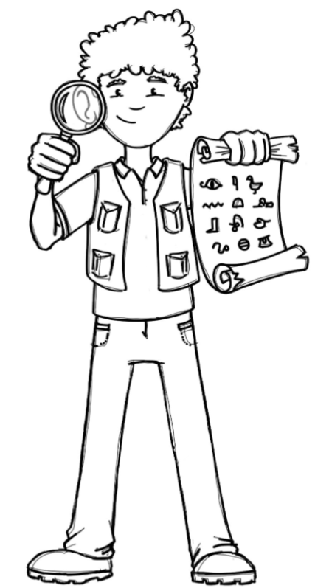
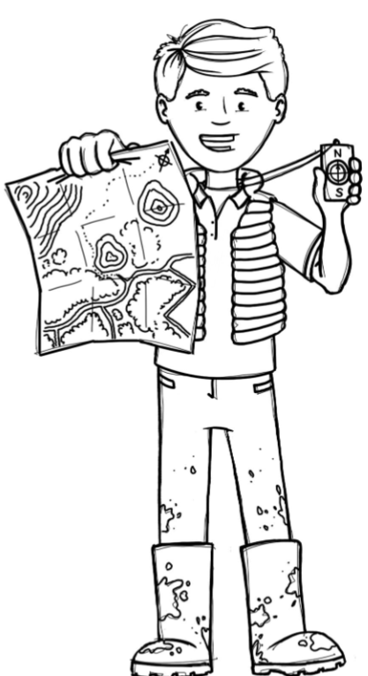
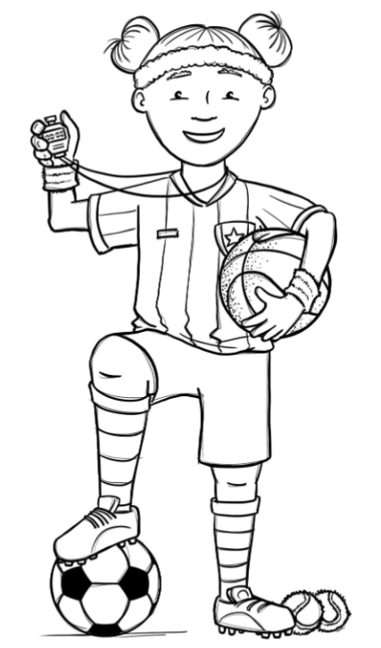
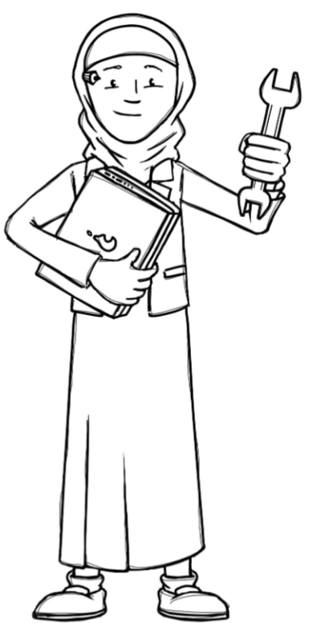
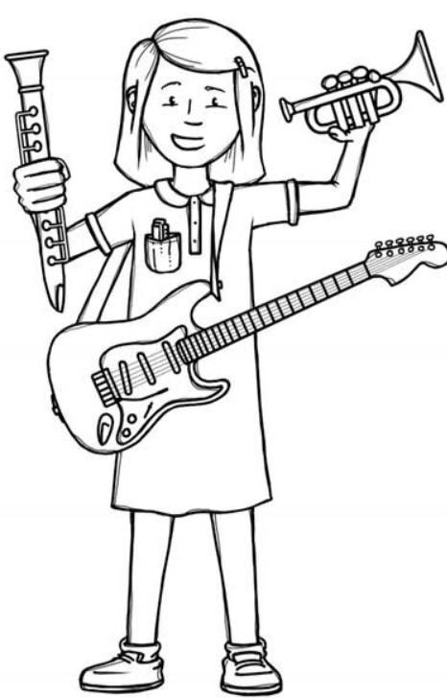
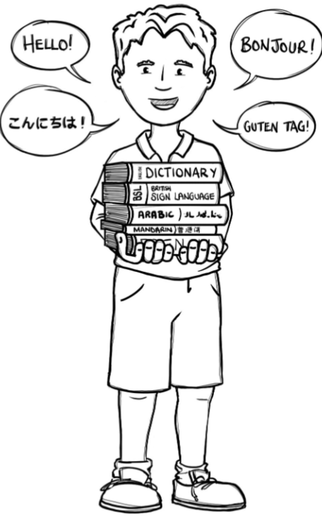
Hedgehogs Class Curriculum Overview—Spring 2
Enquiry: What did Brunel do for Great Britain?
Being Mathematicians
Being Scientists
We will be using our knowledge of mathematics to show what we know about numbers, counting and understanding
amounts working within
20 and extending to 50.
We will be sharing our favourite books and stories and finding out what stories other people like too as part of Book Week. Linked to our enquiry we will be sharing stories about trains, railways and journeys such as the classic ‘Thomas the Tank Engine’.
Being Authors and Readers
We will be finding out about how our school changes in the Spring.
As part of our enquiry we will be using scientific methods to design and evaluate making our own bridges.
Being Historians and Geographers
We will be historians finding out about the life of Isambard Kingdom Brunel. We will discover what a ‘significant’ person is and why they are still important today. As part of our enquiry we will be making a timeline and looking at Victorian transportation.
Being Philosophers
Being Athletes
Taking part in class PE sessions focusing on games and visiting sports coaches playing basketball.
We will be learning about responsibility and what it means. We will also be sharing the Easter story.
Being computer scientists
Being Artists and Engineers
Being a Musician
Exploring logging on in the computer room and using the new ipads!
Being Linguists
We will be designing, making and evaluating our own bridge constructions.
Exploring a variety of musical instruments.
Joining in with singing and rhyming.

