Slide 1
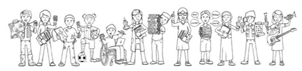
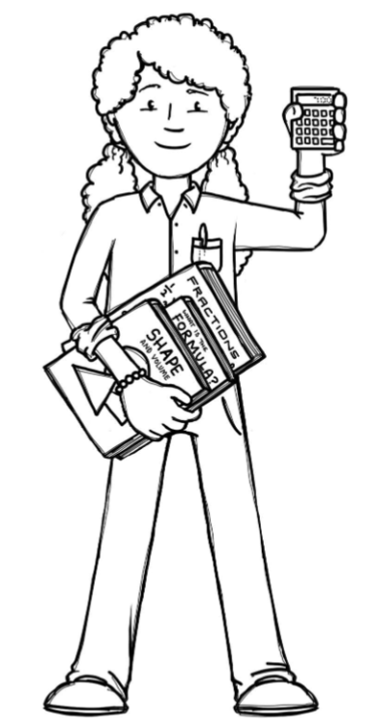

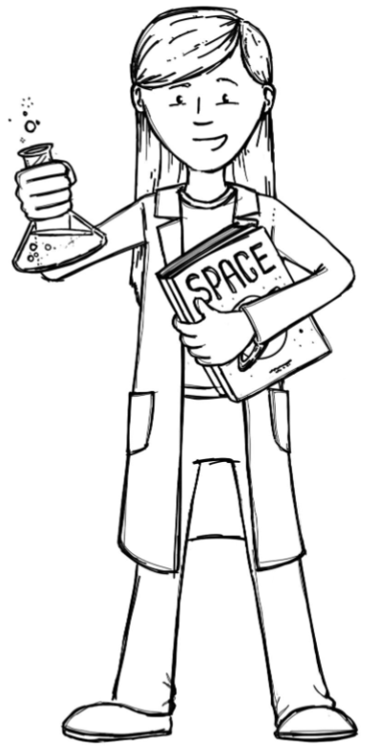

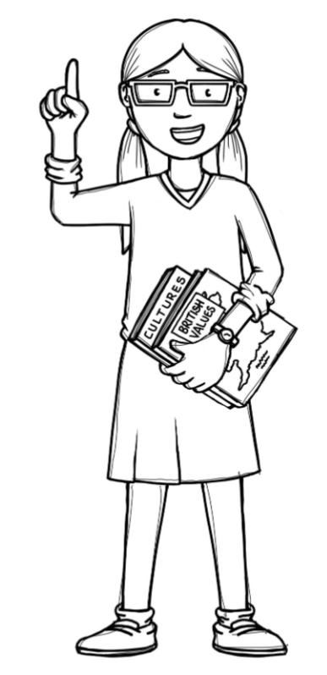
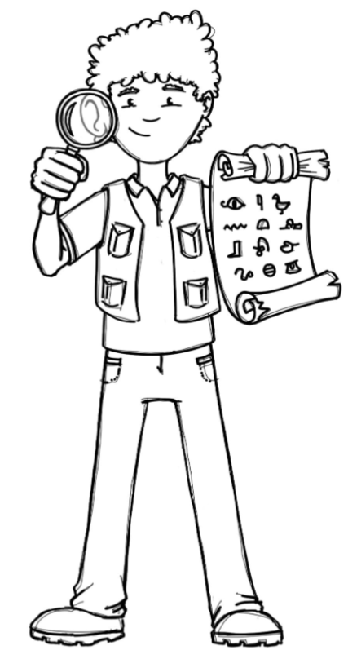
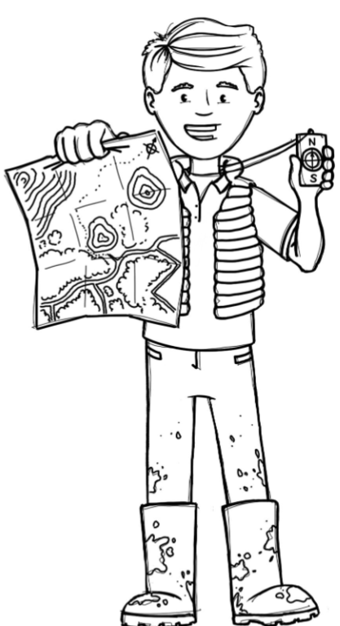
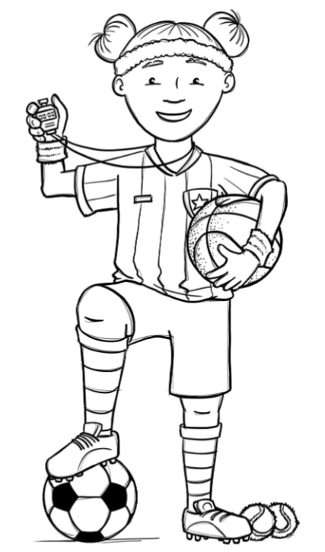
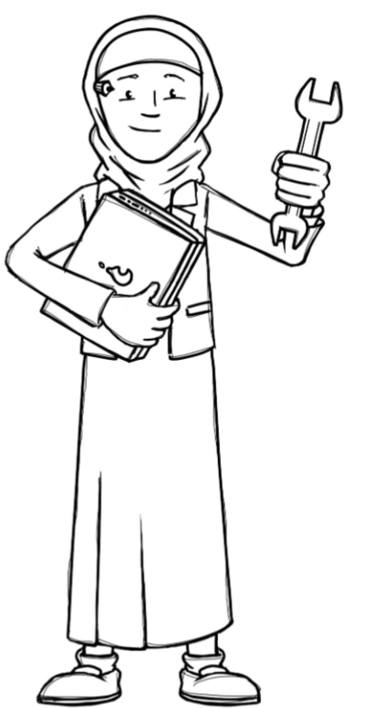
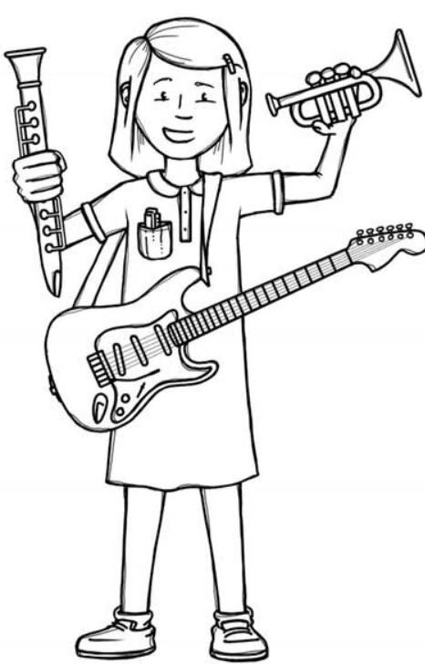
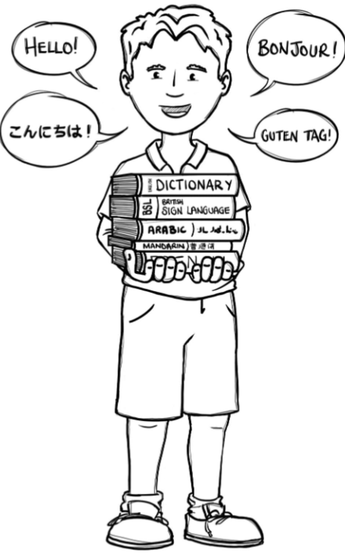
Hedgehogs Class Curriculum Overview—Summer 1
Enquiry: How Do Plants Grow Near Me?
Being Mathematicians
We will be reading stories and non-fiction books about plants and growing. We will use non-fiction books to find out about animals and habitats. Our writing focus will be to use capital letters, finger spaces and full stops.
We will be using our knowledge of mathematics to show what we know about numbers, counting and understanding doubles and composition of numbers to 20 and beyond. We will be starting to learn about fractions and dividing
Being Authors and Readers
Being Scientists
We will be looking at planting in the outdoor area. Observing what plants need to survive and how they grow. We will be finding out about animal homes and habitats.
Being Historians and Geographers
We will be consolidating our previous learning about where we live and where we are in the world. We will be learning about the continents, oceans and countries that make up parts of the world. We will be finding out how animals adapt in different habitats.
Being Philosophers
Being Athletes
Taking part in class PE sessions in class and with the visiting sports coaches learning athletics skills we will need for Sports Day!
We will be learning about looking after ourselves and being healthy. In RE we will be thinking about what makes us special.
Being Artists and Engineers
Being computer scientists
Being a Musician
Being Linguists
We will be making our own observed plant sketches and creating a habitat for an animal.
Exploring a variety of musical instruments.
Exploring logging on in the computer room and using Data and Information Pictograms .
Joining in with singing and rhyming.

