Slide 1
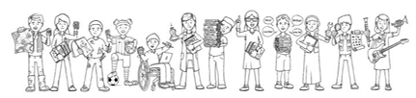

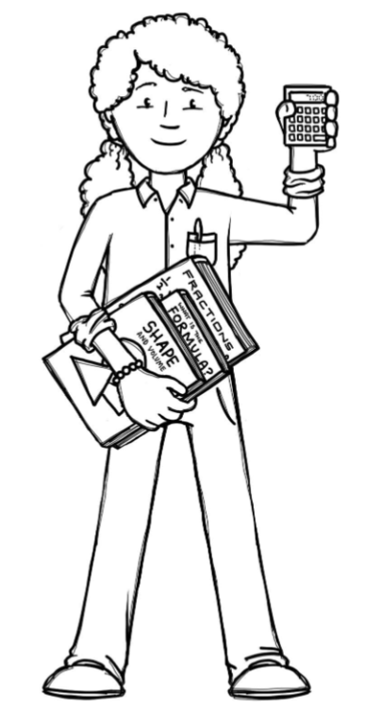
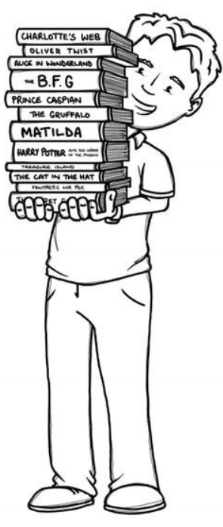
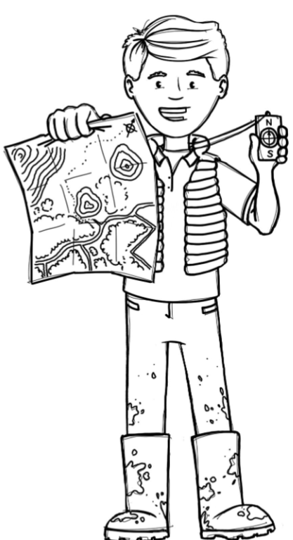



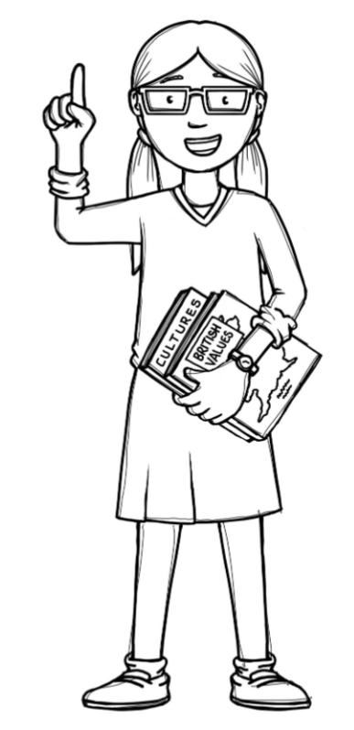
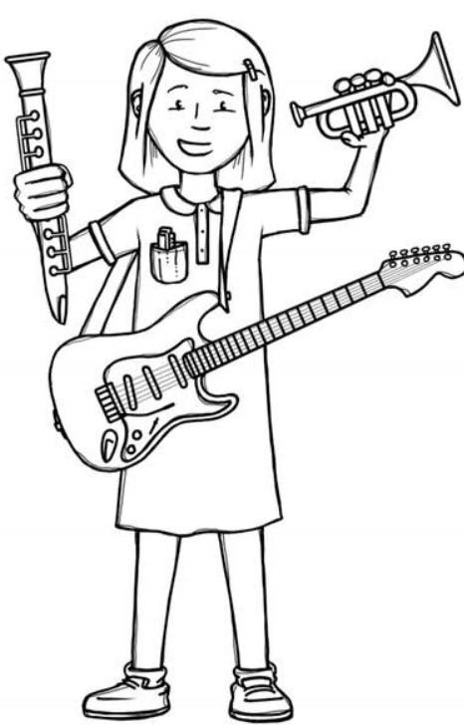
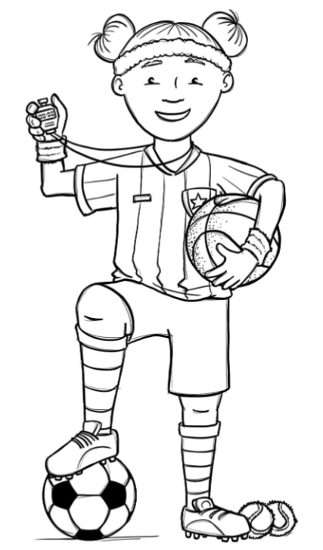
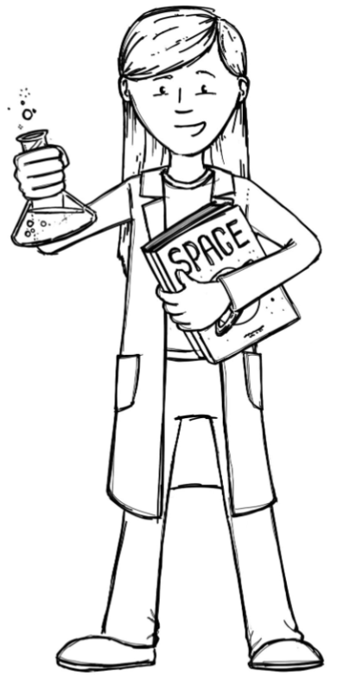
Squirrels Class Curriculum Overview — Autumn 2
Enquiry: How are schools the same?
Being Mathematicians
Being Authors and Readers
Being Geographers
Year 1s will be learning about the teen numbers as well as perfecting their skills of adding and subtracting using up to 10 objects.
Year 2s will be developing their adding and subtraction skills.
Then, we will all be looking at 2D and 3D shapes and their properties.
As Readers, we will continue our phonics and reading with Read Write Inc. We will also be beginning our Class Reader Ellie and the cat. As Writers, we will be writing a poem , a fact file, a diary entry and a narrative. We will also be focusing on letter formation and where letters sit on a line, simple and compound sentence structure, sentence punctuation and spelling tricky words.
This enquiry has us looking at the world we live in including 7 continents and 5 main oceans. We will be looking at where our school is in the world and comparing it to a school in Australia to see what is the same when we look at the physical and human features.
Being Artists
Being Philosophers
This term will be looking at Christianity and the question ‘Why was Jesus given the name Saviour?’ We will also be looking at ‘Valuing differences’ in PSHE.
The Storm break theme this term is about Resilience.
Being Musicians
We will be looking at the aboriginal Artist Emily Kane Kngwarreye looking at how she uses colour and shape in her art and using it to highlight what is the same in schools.
We will be developing our listening,
singing and composing skills using
‘Exploring Rhythm Patterns’ on Charanga as well as singing Christmas songs for our Nativity.
Being Athletes
Being Scientists
Being Computer Scientists
We will be developing our multi –skills with a ball on Thursdays with Prime Sports and our Gymnastic skills on Friday.
We will be using our observational skills and asking simple questions.
We will be learning about how computers follow instructions and using Beebots to perform basic coding.

