Slide 1
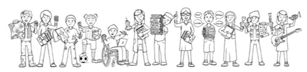






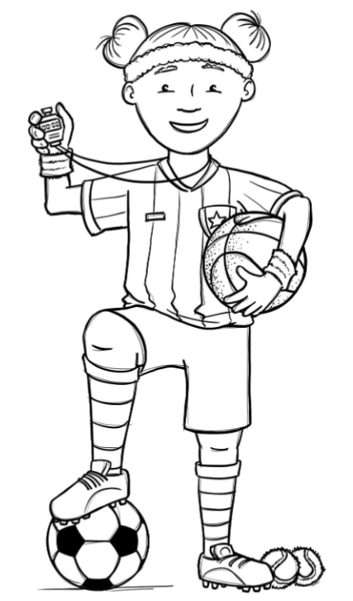
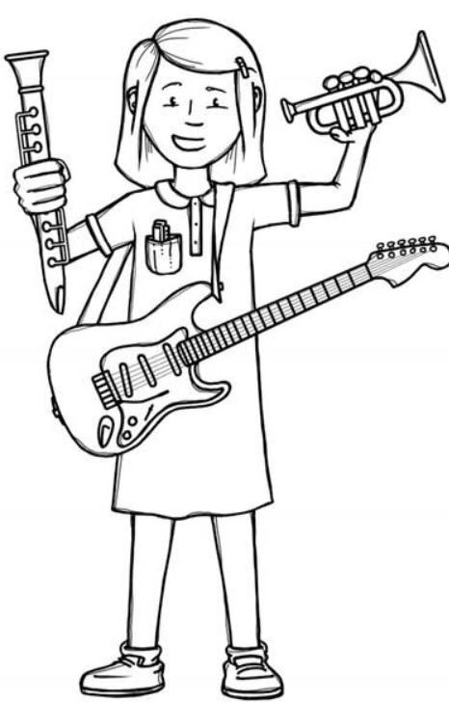
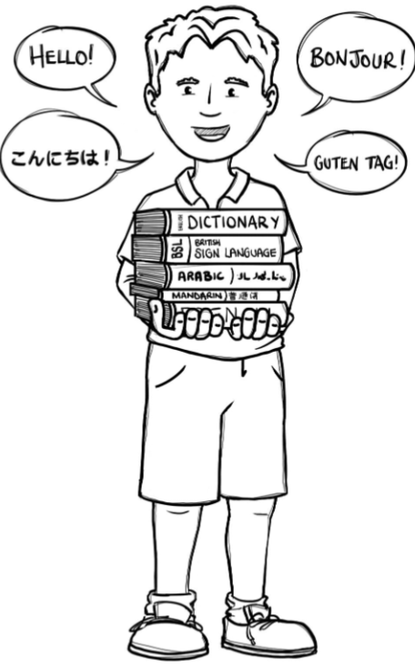
Foxes Class Curriculum Overview—Autumn 2
Enquiry 2: Who were the greater engineers?
Being Mathematicians
Being Authors and Readers
Being Engineers
Fractions
Comparing and ordering
Converting between mixed number and improper fractions
Add and subtracting
Multiply and divide
Multiplication and Division
Long multiplication
Short division
-long division
Solving problems
Author Writer
The Highwayman – poetry
Wild Boy – Narrative
Wild Boy – Newspaper report
Author reader
Comprehension crusher – The good ferryman and the water nymphs
Comprehension crusher – The circulatory system and the Heart.
SAT’s style questions
What makes a good bridge?
How are complex structures made?
What criteria would you use to design a new bridge?
Being Historians
Where does Bronze Age, Iron Age and Stone Age sit on a timeline?
How did life change from the Stone Age to the Iron Age?
What was the most significant achievement of the Ancient Britons?
What were the most significant engineering inventions of the Victorian era and who were they made by?
Being Philosophers
Being Athletes
PSHE – Value difference
R.E - Islam – How does Tawhid create a sense of belonging to the Muslim community?
Hockey – Prime sports led
Fitness – Teacher led
Being Artists
Being a Musician
Being computer scientists
Being Linguists
Charanga
– Music remixed
Family
Great artist, architects and designers in history – link to bridges
Creating media – Web page creation

