Slide 1
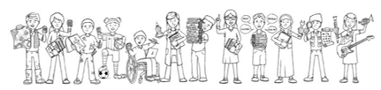
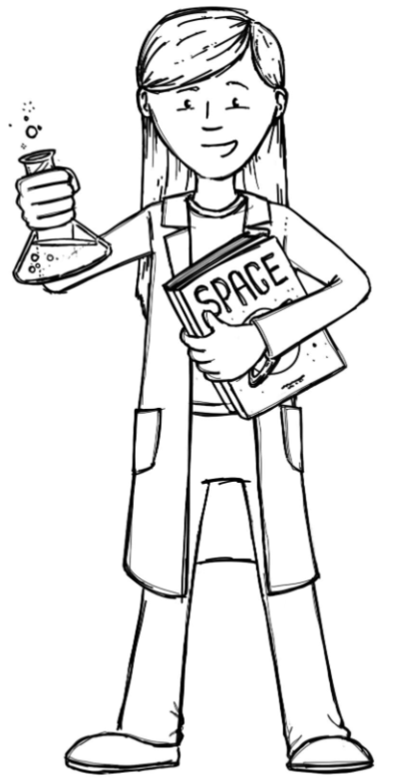


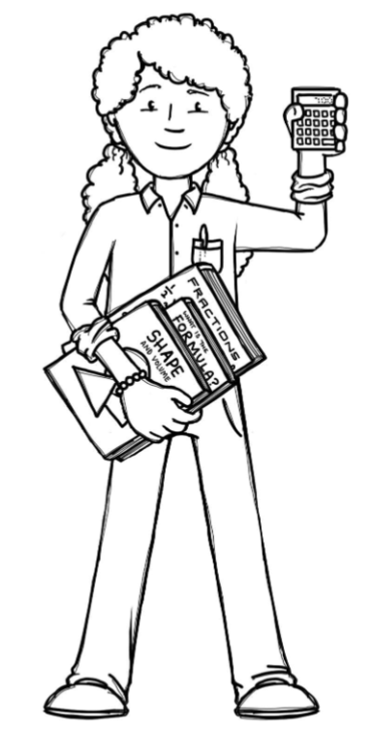
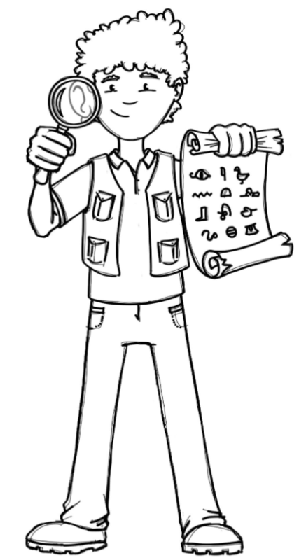
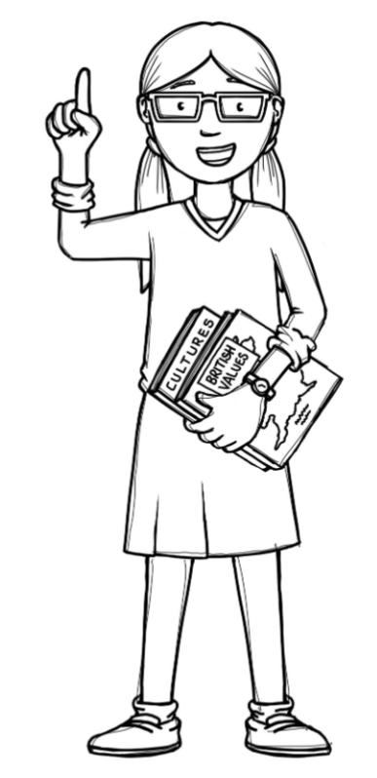
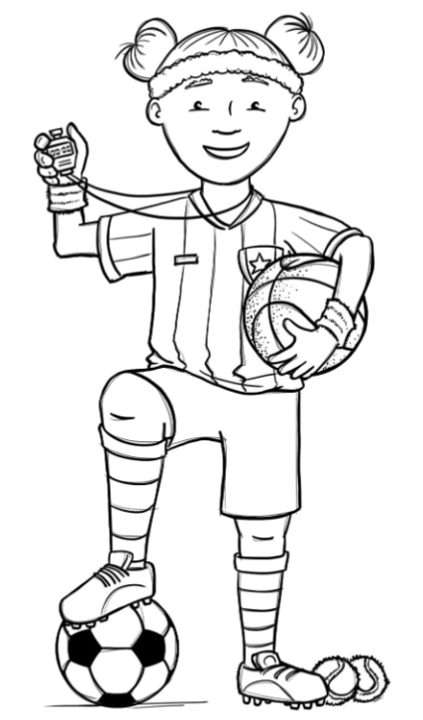
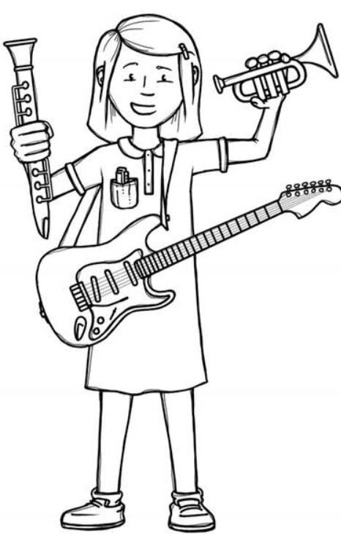
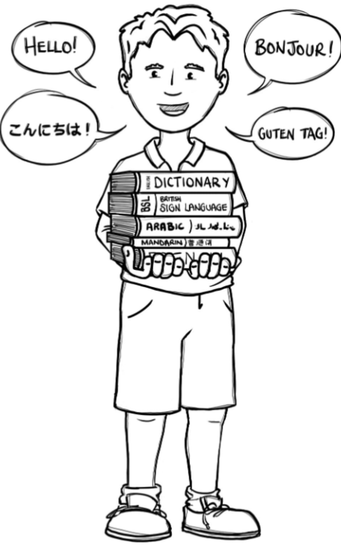
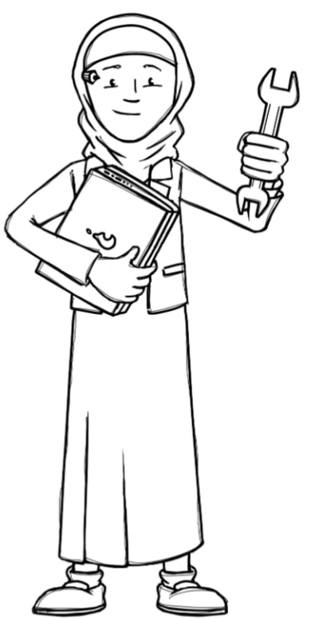
Foxes Class Curriculum Overview—Spring 1
Enquiry 3: Darwin and Linnaeus – How are they connected?
Being Mathematicians
Being Scientists
Year 5
- Fractions
- Decimals
Year 6
- Ratio
- Algebra
Year 5 and 6
- Fractions, decimals and percentages
Being Authors and Readers
Author Writer
Poetry – This is me
Narrative – The depth of the lake and height of the sky
Balanced argument – Should beavers be released back into the wild?
Class reader – Darwin's Dragons
Author Reader
Charles Darwin
Carlos Linnaeus
SAT style questions
Comprehension Crusher: A day in the life of a Cardiologist and A Day in the Life of a pharaoh
Comprehension Crusher: New species discovered on the Galapagos/ moon landings
How do we classify living things?
What characteristics help us classify plants and animals?
What do fossils tell us?
How might offspring differ from their parents?
What is adaption and what do we mean by adaption?
Being Historians
Being Philosophers
Who was Linnaeus?
Who was Darwin and how do we know about their work?
How do scientific ideas change over time?
SCARF – Keeping Safe
EMMANUEL - Hinduism
How do questions about Brahman and atman influence the way a Hindu lives?
Being Athletes
Prime sports led – Football
Teacher led - Dance
Being Artists
Being a Musician
Being computer scientists
Being Linguists
Express Yourself – Graffiti art
Charanga: Yu Studio – a spooky story project
Teach computing – Variables in games
At the tea room

