Slide 1
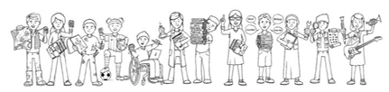
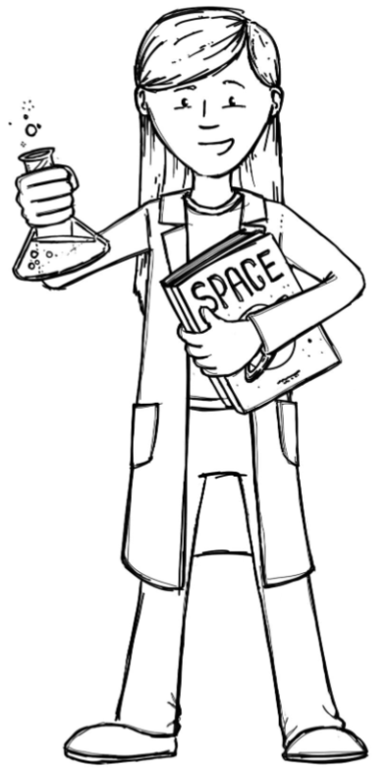
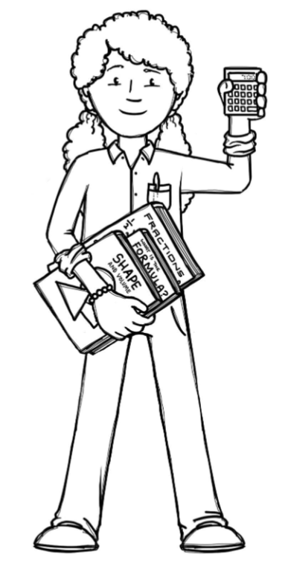

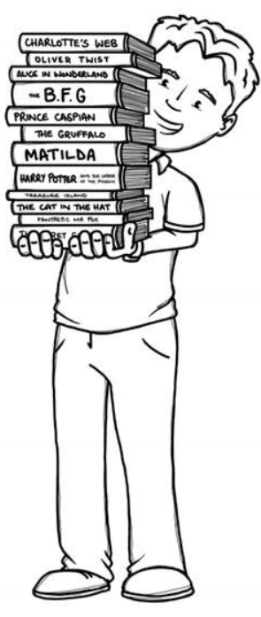
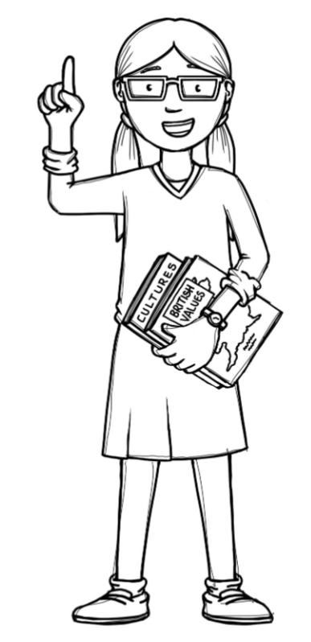
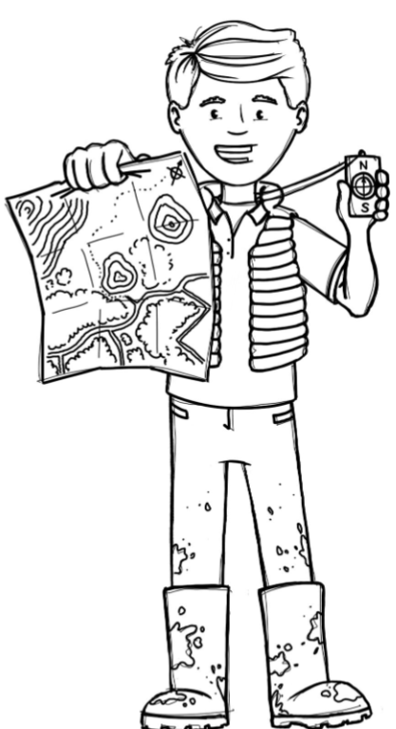
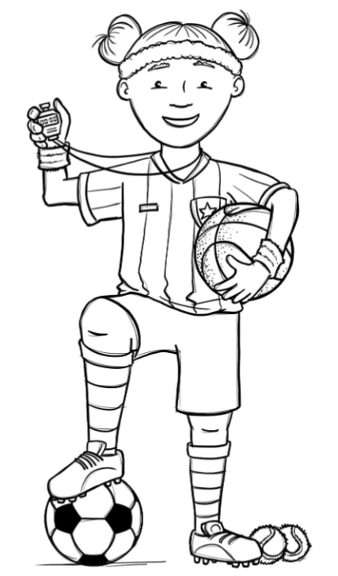
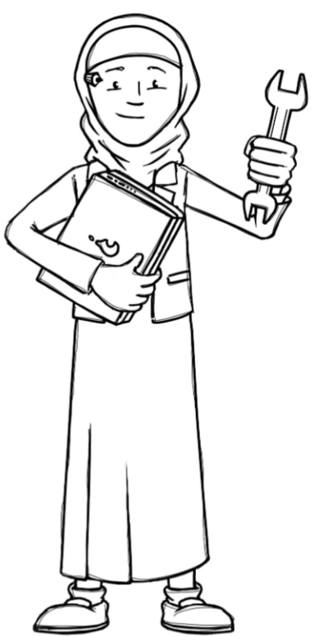

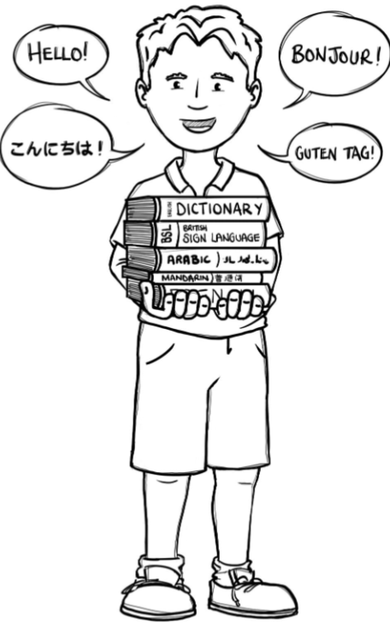
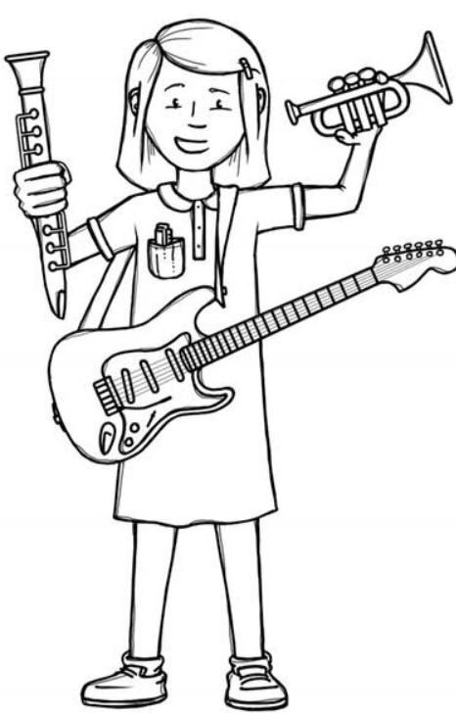
Foxes Class Curriculum Overview—Summer 1
Enquiry 5: Why are shadows important?
Enquiry 6: How big is your footprint?
Being Authors and Readers
Being Mathematicians
Being Scientists
Author Writer
Narrative - The Fantastic Flying book of Mr Morris Lessmore
Revisit Biography
Revisit Narrative
Revisit Argument
Author Reader
Comprehension Crushers:
- Viking Monsters and Norse Gods
- The Legend of Ragnar Lothbrok and The Blood in the snow.
Year 5 and 6
Shape
Area, perimeter and volume
Position and direction
How does light travel?
How do we see objects?
Do shadows always have the same shape as the object?
Where does electricity come from and how is it used in our homes?
What is a series circuit and what are the recognised symbols used?
How does changing one component affect the circuit?
Being Geographers
Being Philosophers
How is our energy produced and is it all renewable?
Where is the world’s energy produced?
What do we mean by our ‘footprint” and how might we measure it?
Being Athletes
R.E – EMMANUEL - Christianity Should believing in the resurrection change how Christians view life and death?
PSHE - SCARF – Being my best
Prime sports led – Tri-golf
Teacher led – Athletics
Being Artists
Being Linguists
Being a Musician
Being computer scientists
How do Artists use shadows in their artwork?
What art techniques can we create using shadows?
How can we explain the use of shadows in art?
How can we represent our ‘footprint’ as artists?
BBC Ten Pieces Clapping music by Steve Reich
NC Link – 3D modelling
(Teach Computing Plans 6,5)
Language angels
–At the tearoom

