Slide 1






Hedgehogs Class
Meet the Teacher

Slide 2

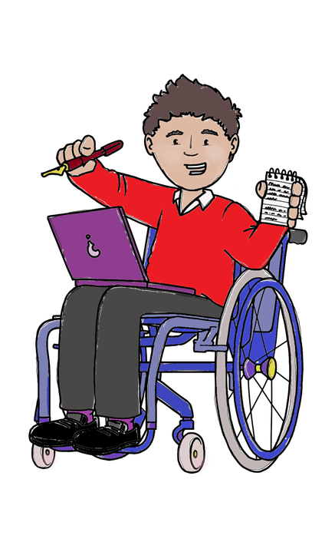
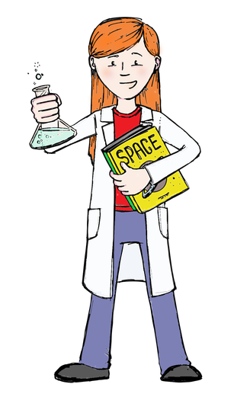
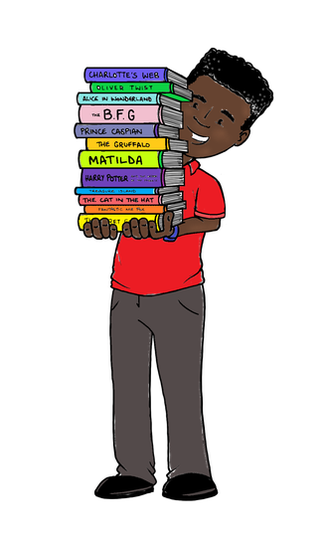
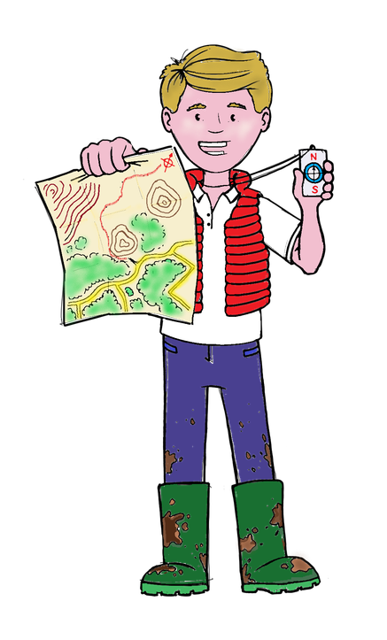
Every day we have:
Phonics
Writing
Maths
Fine Motor Activities
Every week we have:
Art and DT PE
Music Science/History/
Computing Geography

Slide 3

Every week we will have:
Show and Tell
PE days (Mon and Thurs)
Swap Library books
Things to remember
Some weeks we will have additional activities:
Forest School Monday 5th October
Harvest Festival 8th October

Slide 4
After School
After school clubs
starting next week these usually run from 3.15pm to 4pm
Reception children are invited to attend clubs after the first term - just to settle them first
Things to remember

Slide 5
Rewards and Updates
Class Dojo for updates, photographs and a record of your child’s learning
Dojo points and Star Jars when you get to 20 Bronze Award, 40 Silver Award, 60 Gold Award, 80 Platinum Award
Friday Achievement Assembly 2.45pm Headteachers Award, Pupil of the Week and Learnimals

Slide 6
Rewards and Updates
Once a month the Friday Achievement Assembly at 2.45pm will be held in Church.
Awards will be for Reading, Writing and Maths
Katie Manley Cup awarded for kindness, thankfulness and perseverence

Slide 7

Any questions?

Slide 8
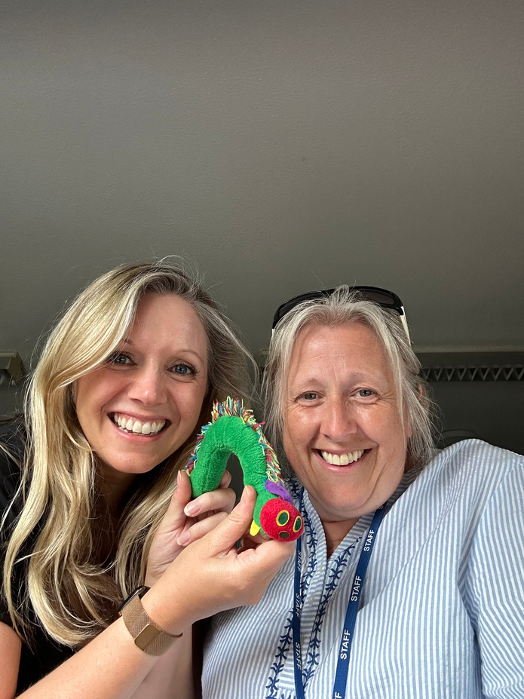


Thank you for coming your support is appreciated!
Your Hedgehogs Team Mrs Shean and Mrs Oram

