Slide 1
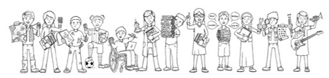


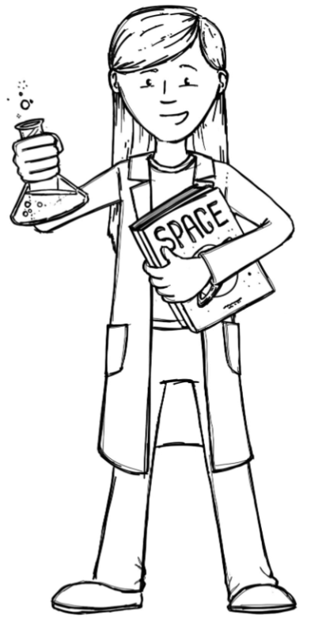
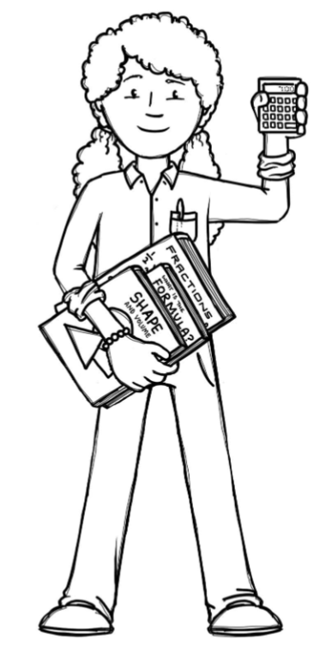
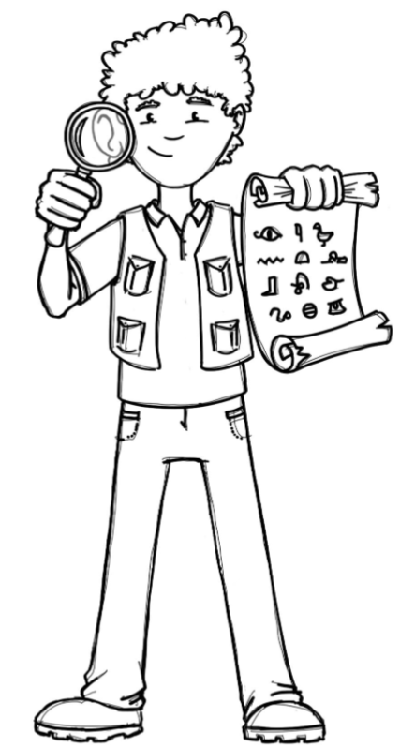
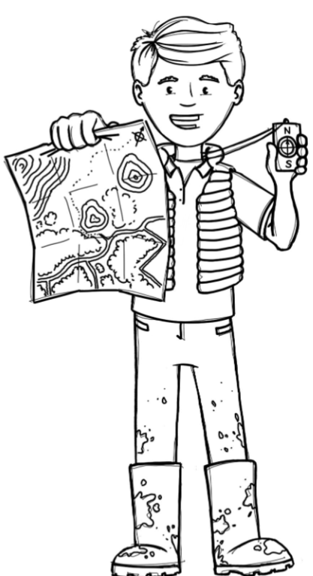
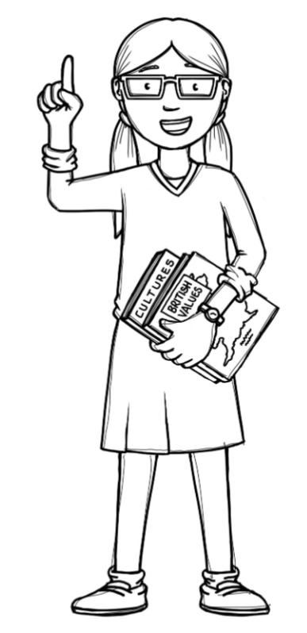
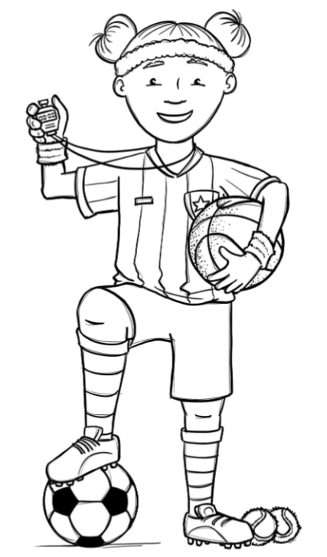
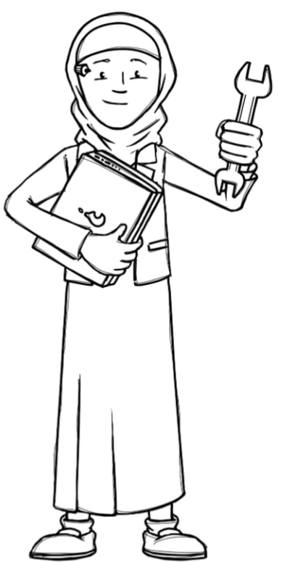
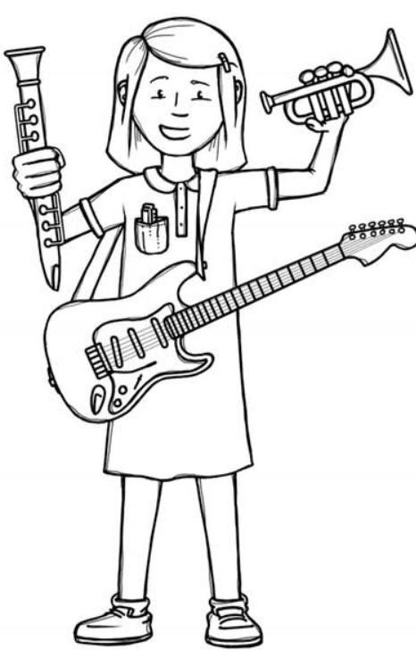
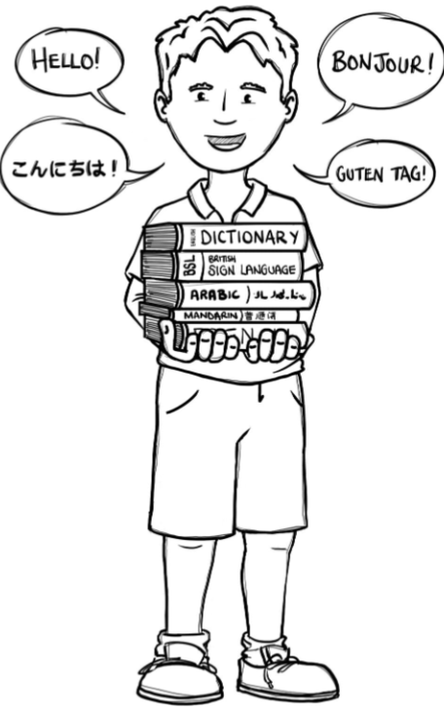
Hedgehogs Class Curriculum Overview—Autumn 1
Enquiry 1: What do Artists do?
Being Mathematicians
Being Scientists
We will be using our knowledge of mathematics to show what we know about numbers, counting and understanding amounts.
We will be sharing stories about starting school and being ourselves.
We will be working on starting to write and explore mark making in various forms.
Being Authors and Readers
We will be finding out about how our school changes in Autumn. We will be
looking at differences when the
seasons change and what signs
to look for.
Being Historians and Geographers
We will be finding out about where
we live, looking at the local area
and talking about who is in our family.
Being Philosophers
Being Athletes
We will be going to the Church to look at what is important to Christians.
Taking part in class PE sessions with our class teacher.
Being Artists and Engineers
Being computer scientists
Being a Musician
Exploring logging on in the computer room.
Being Linguists
Investigating ‘dot’ art and creating our own art gallery.
Exploring a variety of musical instruments.
Joining in with singing and rhyming.

