Slide 1
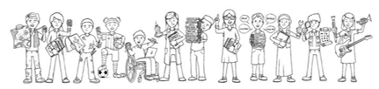

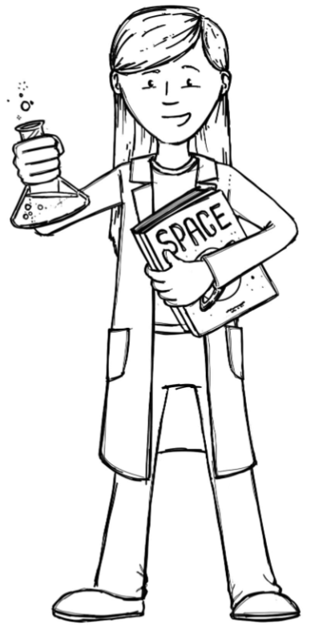
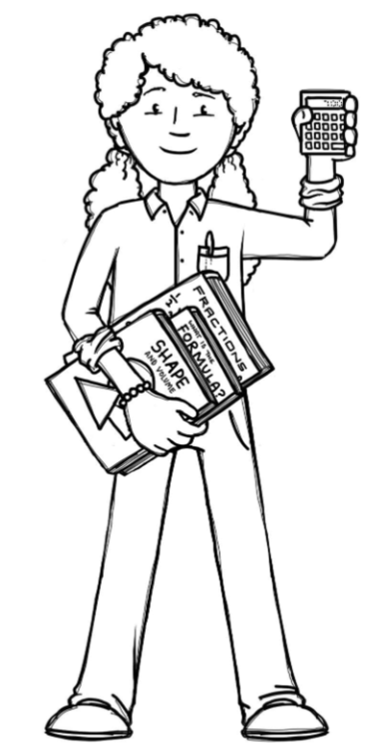

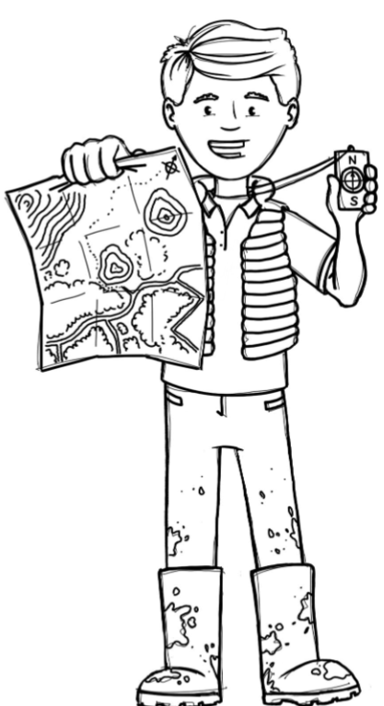
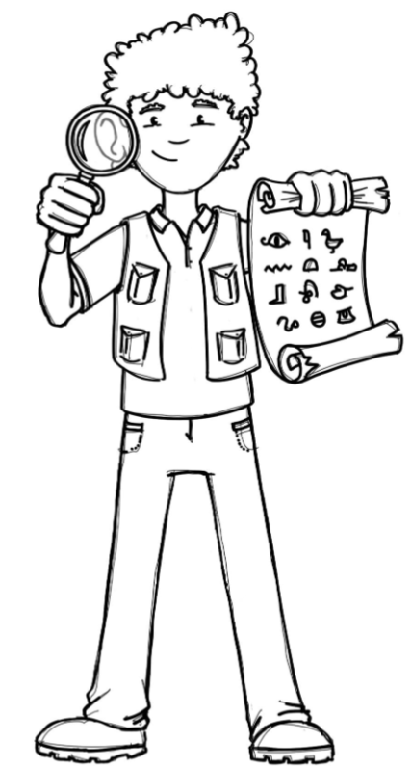

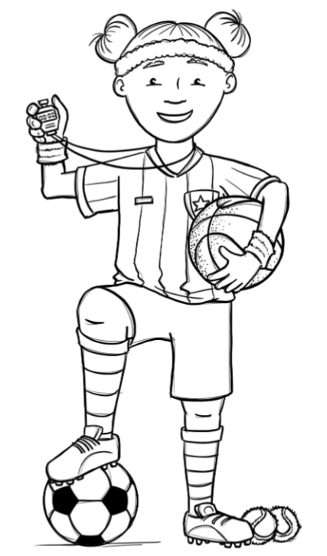

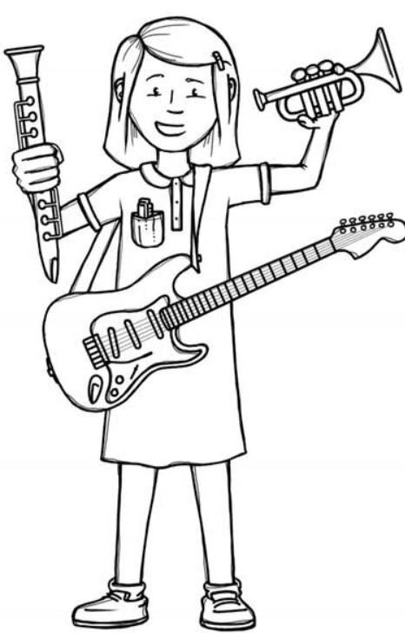

Foxes Class Curriculum Overview—Autumn 1
Enquiry 1: What does Earth look like from the Solar System?
Being Mathematicians
Being Authors and Readers
Being Scientists
Place Value
Addition and Subtraction
Multiplication and Division
Fractions
Being Authors
Basics
Lights on Cotton Rock - Narrative
Transition to Mars – Journal
Poetry
Author Readers
Jamie Drake Equation
Sia Titanium
Sia Alive
Sia Elastic Heart
Dorothy Vaughan
Margaret Hamilton
Comprehension Crushers
Space, Tourism and Astronauts
Galapagos and Moon landings
How do we know that Earth, Sun and the Moon are spherical bodies?
How does the Earth and other planets move?
How does the Earth and Moon orbit?
Why is there Day and Night on Earth?
Being Geographers
Being Philosophers
What can we see from the ISS?
What is Longitude?
What is Latitude?
SCARF: Relationship
Emmanuel: Why is the Gospel such good news?
Being Athletes
Being Artists
Get Set 4 PE
- Gymnastics
- Rugby
What the Earth looks like from the solar system.
How to use Acrylics.
Annotate pictures seen from space.
Use Acrylics to create what Earth looks like from the ISS.
Being a Musician
Being computer scientists
Charanga: Unit 1 - Melody and Harmony in music
Teach computing: Computing Systems & Networks
Being Linguists
Language Angels – The Date

