Slide 1






Squirrels Class
Meet the Teacher

Slide 2

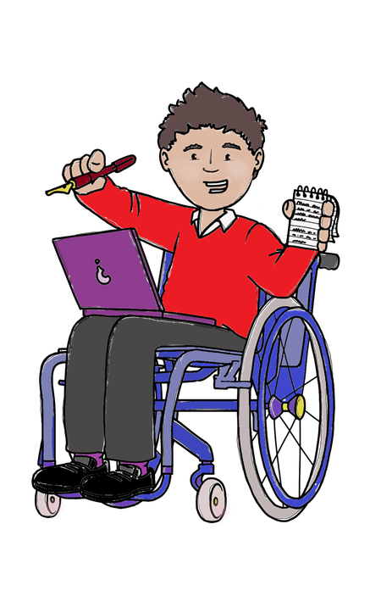
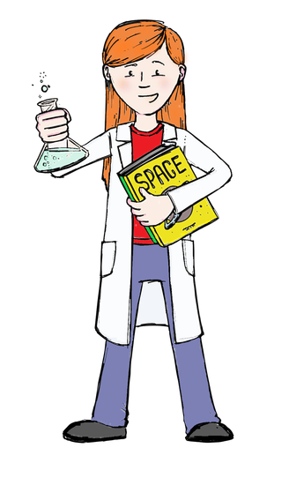
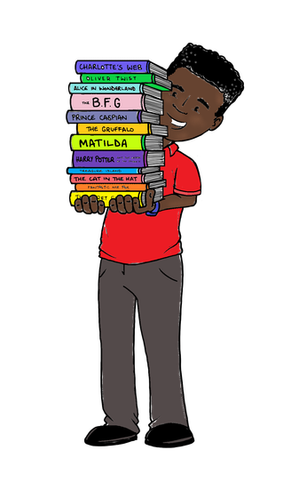
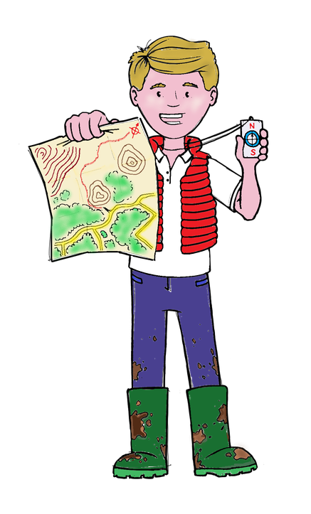
Every day we have:
Phonics
Writing
Maths
Assembly
Every week we have:
PE (Mon & Tues) PE / RE
Music PSHE
Curious City (Art or DT or Science or Humanities)

Slide 3

Every week we will have:
PE days (Mon and Tues) – but
please ensure PE kit is in everyday in case
weather / events change the day.
Things to remember
Some weeks we will have alternative activities (replacing non-core subjects:
Forest School (timetable to be issued)
Harvest Festival 8th October
Class / Keystage Visits.

Slide 4
Reading books
RWI scheme
3 reads a week with class adult
Reading books changed Friday
to return the next Friday.
After School:
After school clubs
starting next week these usually run from 3.15pm to 4pm.
Things to remember

Slide 5
Things to remember
Home items / toys:
Avoid bringing these in as these can
be a distraction and if they get lost or damaged, they cannot be replaced.
Label clothes:
Label clothes – this means it is easier to sort on warm days and PE days.

Slide 6
Developing independence:
Practice getting changed for PE at home
Practice doing up own coat at home
Practice sticking things neatly onto paper
‘Explore / challenge time’ does not happen as frequently as Hedgehogs due to curriculum
Sharing home achievements:
Any certificates / special events can be shared in class at end of the day – but we don’t do show and tell.

Slide 7
Rewards
In class:
Marbles in a jar for a class reward – for excellent class behaviours
Table of the week – the table following instructions get to go line up first.
Friday Achievement Assembly 2.45pm:
Headteachers Award (values)
Pupil of the Week (focus / effort / manners)
Learnimals (learning powers).
Dojo points for excellent learning work: when you get to 20 Bronze Award, 40 Silver Award, 60 Gold Award, 80 Platinum Award.

Slide 8
Rewards
Once a month the Friday Achievement Assembly at 2.45pm will be held in Church.
Awards will be for Reading, Writing and Maths.
Katie Manley Cup awarded for kindness, thankfulness and perseverance.

Slide 9

Any questions?

