Slide 1
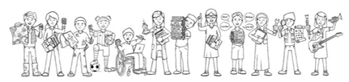


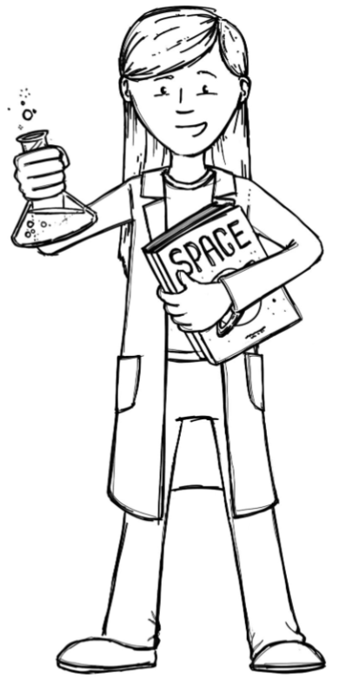
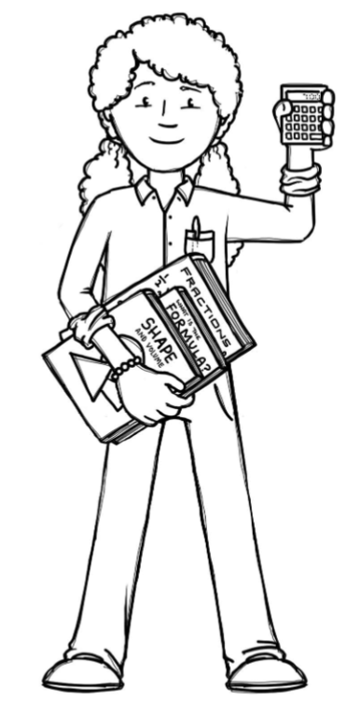
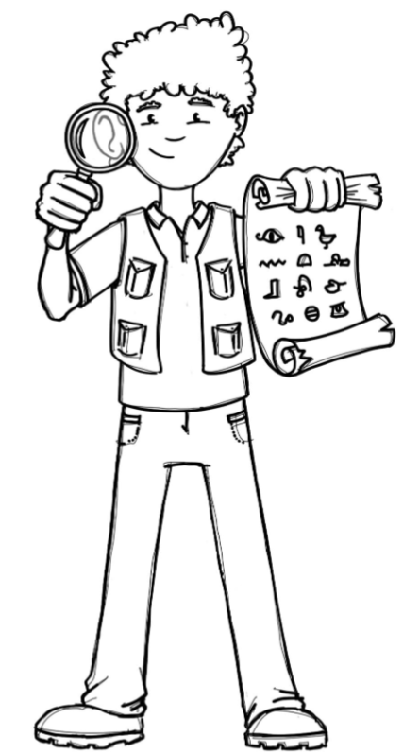
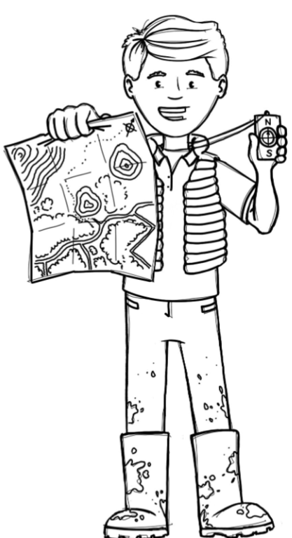

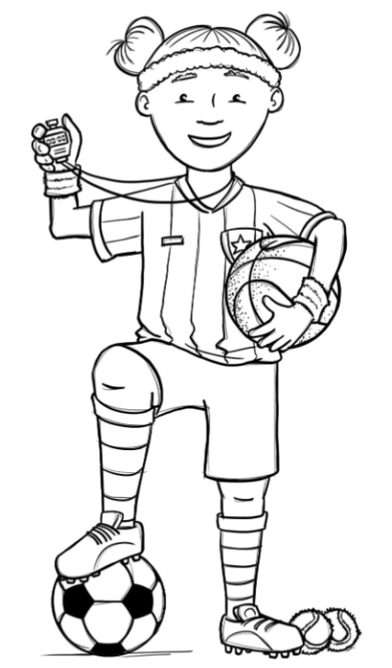
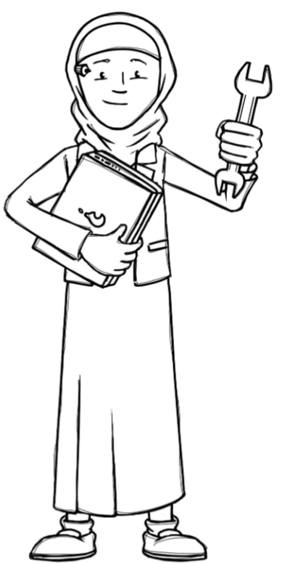
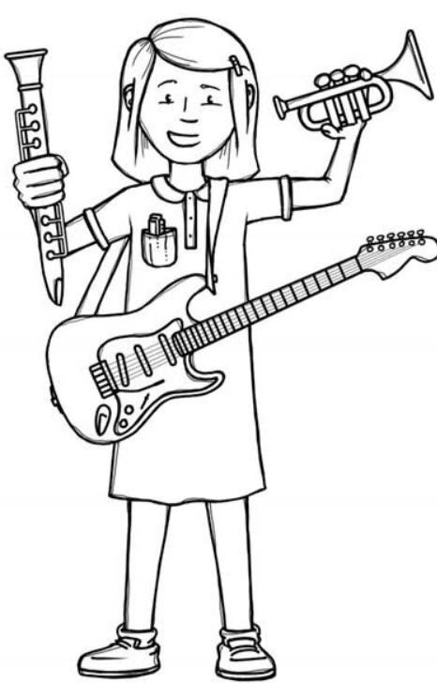
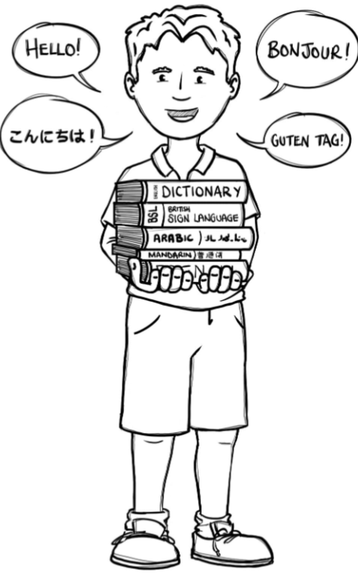
Squirrels Class Curriculum Overview—Autumn 1
Enquiry 1: What do Artists do?
Being Mathematicians
We will be exploring narratives around feelings and changes, poetry, and non-fiction.
We will continue with RWI phonics and developing our phonic reading skills with digraphs (two letter sounds),
Being Scientists
We will be using our knowledge of mathematics to show what we know about numbers, counting and understanding amounts.
This covers place value, representation, addition and subtraction to 20. Y2 will
practice x10, x2, x5.
Being Authors and Readers
We will be finding out about how our school changes in Autumn. We will be
looking at differences when the
seasons change and what signs
to look for.
Being Historians and Geographers
We will be finding out about where
we live, looking at the local area
and talking about who is in our family.
Being Philosophers
Being Athletes
We will be exploring how
Christians feel a sense of belonging.
Taking part in class PE sessions
with our class teacher. Ball skills and controlling movements / balance.
Being Artists and Engineers
Being computer scientists
Being a Musician
Information technology
around us and
Internet safety
Being Linguists
Investigating ‘dot’ art and
creating our own art gallery.
Keeping a rhythm.
Joining in with singing and rhyming.

