Slide 1

Welcome to badgers MEET THE TEACHER
Wednesday 9th September 2026

Slide 2
Staffing
Mrs Gulliford –Tuesday, Wednesday, Thursday and Friday
Mrs Cheeseman- Monday
Mrs Cutler- Monday-Friday
Miss Travers- Monday to Friday
Miss Gregory- Wednesday, Thursday and Friday

Slide 3
Badger class timetable
Day | 8.45 – 9.05 | 9.05 – 10.05 |  | 10.05 – 10.30 | 10.30 – 10.50 | 10.50 – 11.10 | 11.10 – 12.10 | 12.10 – 12.25 | 12.25 – 1.15 | 1:15-1:35 | 1.35 – 2.15 |  | 2.15 – 2.50 |  | 2.50 – 3.10
Monday | Spellings Nessie | Maths 9:05-9:50 |  | English 9:50- 10:25 | Assembly | Break time | PE | Number sense- Times tables | Lunch time | French |  |  | Music |  | R4P
Tuesday | Spellings Nessie | English |  | Whole Class reading
Tuesday | Spellings Nessie | English |  | Whole Class reading |  |  | Maths | Stormbreak/ daily mile |  | Number sense- TT | Computing |  | RE |  | R4P
Wednesday | Spellings Nessie | English |  | Whole Class reading |  |  | Maths | Stormbreak/ daily mile |  | Number sense- TT | Curious City |  |  |  | R4P
Thursday | Spellings Nessie | English |  | Whole Class Reading |  |  | Maths | Stormbreak/ daily mile |  | Number sense- TT | Curious City/ Art |  |  |  | R4P
Friday | Spelling | English | Whole class reading |  | Library |  | Maths | Stormbreak/ daily mile |  | Number sense- TT | PE 1:30-2:15 | 2:15- 2:40 PSHE |  | 2:45 Celebration assembly | R4P

Slide 4
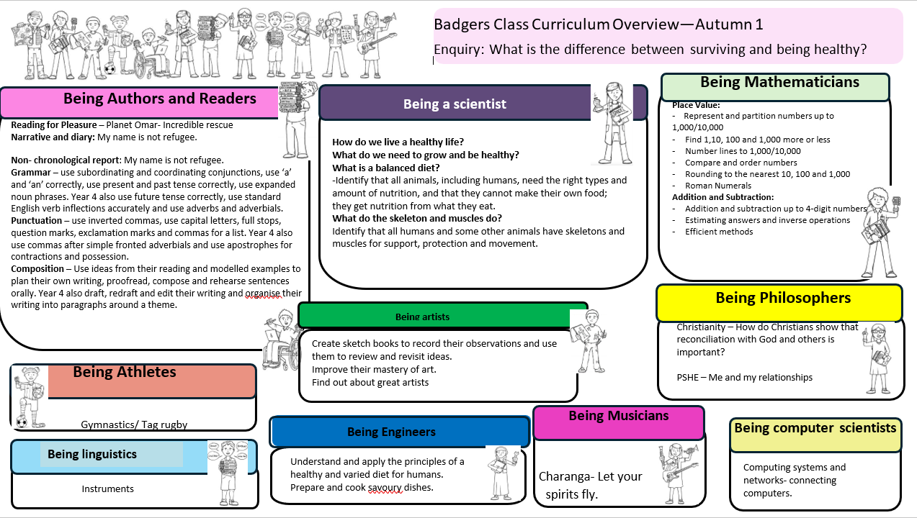

Slide 5
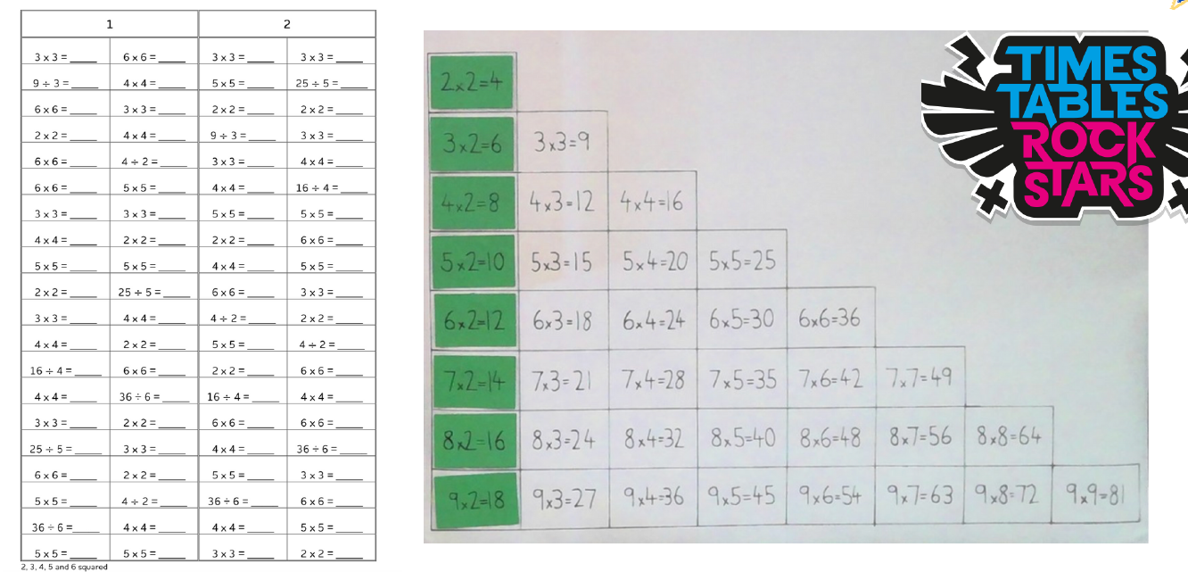
Times tables

Slide 6
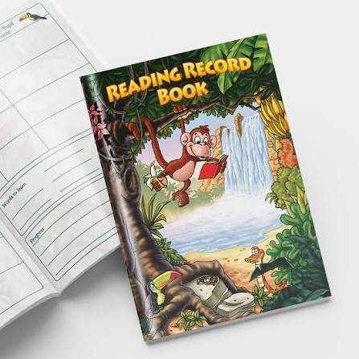

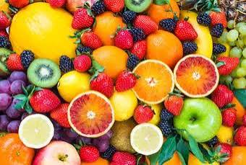
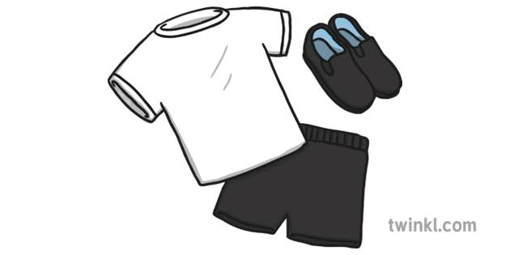


What to bring to school
Reading book and reading record every day
Water bottle
Snack
PE kit on Monday and Friday
A coat with a hood- if the weather looks rainy.
A hat in warmer weather.
Please no toys.

Slide 7



Golden rules: Christian Values:
Stars: Certificates: Houses:
Headteacher award. Chaffeymoor
Pupil of the week Queen Oak Learnimals Sandways

Slide 8


Learnimals
Concentrating Camel, Questioning Queen Bee, Persevering Penguin, Imagining Iguana, Noticing Newt , Reviewing Rabbit, Teamwork Tiger, Planning Panda, Have a Go Hyena, Reasoning Robin

Slide 9
thank YOU FOR COMING

