Slide 1
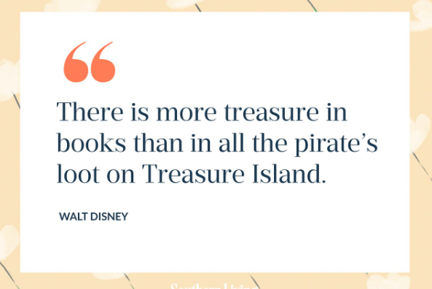
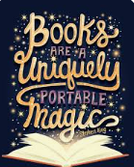
Reading Newsletter October 2024
“”

Slide 2
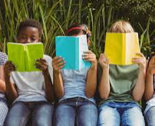
Reading at St Georges
Welcome to the first edition of the reading Newsletter for this school year.
In this edition:
A note from the English Lead.
A big thank you!
The Reader Teacher
Book recommendations
Our featured author this term
Book reviews needed!

Slide 3
The importance of reading with your children…
As a busy parent myself, I know how hard it can be to find time for reading with your child.
Sharing books and stories with children helps their learning, development, language and communication.
Not only do children learn vital skills for later reading and writing, but sharing books also helps with talking, listening, and communication skills.
Sharing books also encourages imagination, curiosity, and emotions.
Learning to read unlocks their ability to learn and offers your children a greater chance of success in the future.

Slide 4
Just take a look at our wonderful library! We want to say a huge thank you for your amazing donations last term – our library is bursting at the seams with joyful titles.
Also a big thank you to all of our Year 5 and Year 6 librarians! What a fabulous job they are doing keeping everything looking neat and tidy!

Slide 5
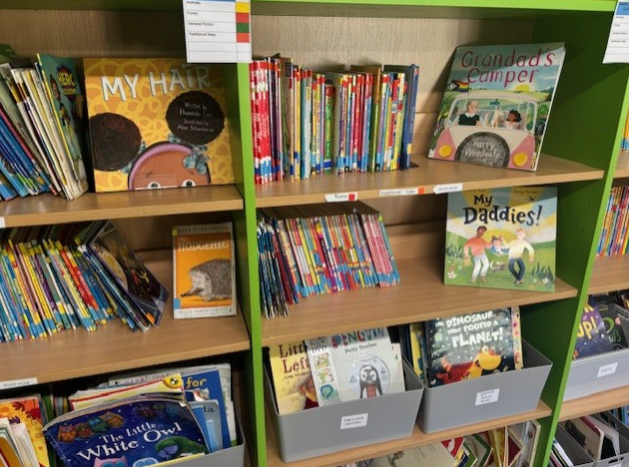
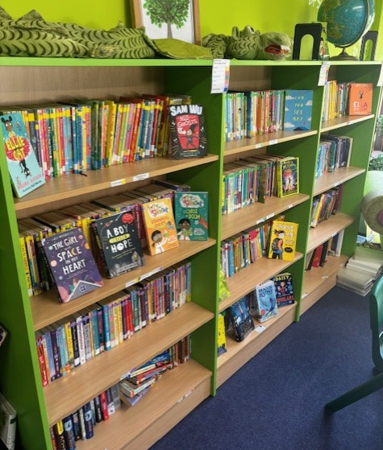
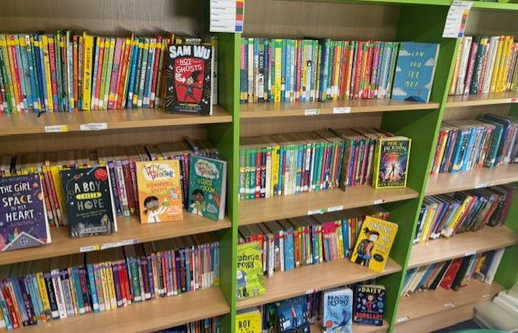
We are very proud of our library!
So many wonderful new texts!
Thank you!

Slide 6
The Reader Teacher is a great website choc-a-block with all of the latest good reads for primary aged children. Your child will be coming home with a reading list of recommended books next week but do take a look at the website. https://www.thereaderteacher.com/

Slide 7
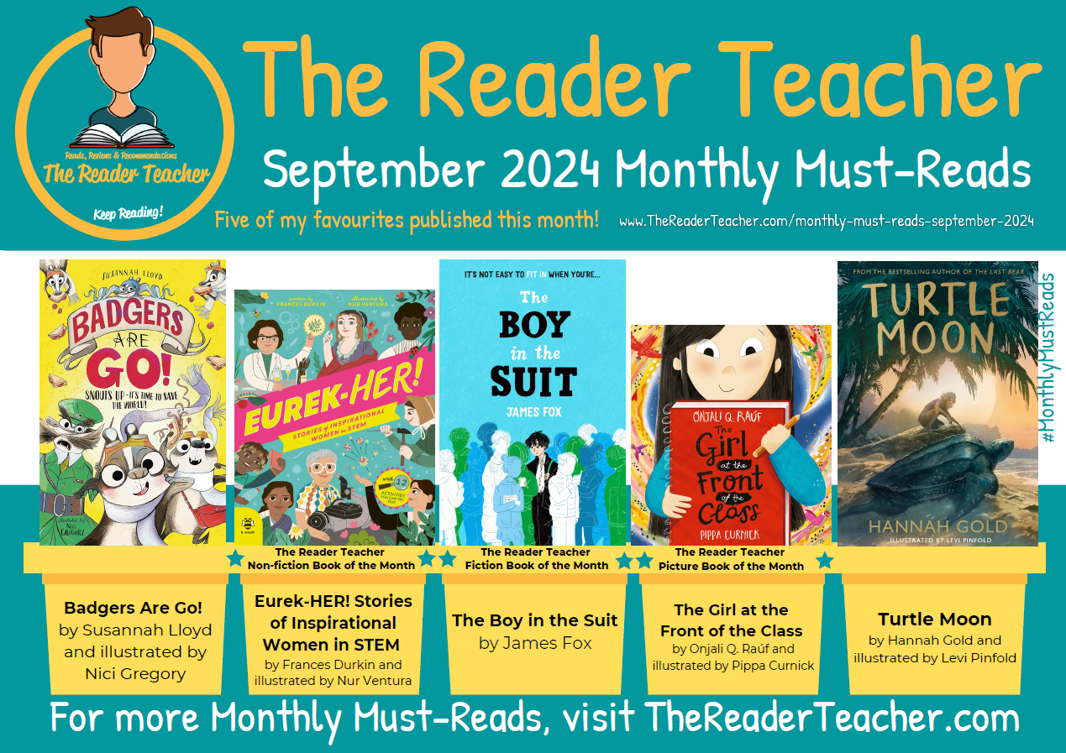

Slide 8
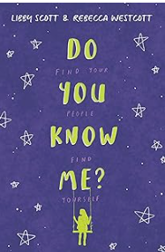
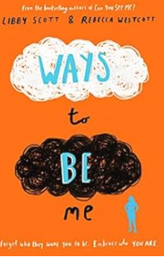
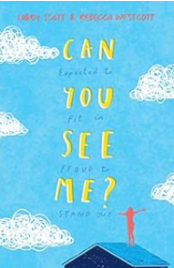
Author of the month!
Libby Scott
Libby Scott loves hot chocolate, Taylor Swift and her dog Charlie. She is also autistic, and after her mum Kym shared a piece of Libby's writing online, Libby and her writing went viral and prompted a book deal from the biggest children’s publisher in the world, Scholastic.
Her first novel, Can You See Me, came out in 2019 when she was 9 years old. She subsequently has written 2 more books with Rebecca Westcott.

Slide 9
Book Reviews
If you have recently read a book and want to recommend it to others read on…
I am looking for book reviews to add to our reading newsletter each term. Please tell me all about a book you have read and why you enjoyed it. Make sure you add your name and your review could be published on our next newsletter!

Slide 10
Blue Peter Badges
We already have several children who have earned themselves a Blue Peter badge for reading.
To earn this badge, you must:
Be aged between 5-15 years old.
Tell Blue Peter about a book you have read and what you think about it. Maybe you liked the characters, or perhaps you enjoyed going on exciting adventures in faraway places.
Upload your illustration of a character or a scene from the story. This could be a drawing, painting or even digital artwork.
Let them know what other books and authors you have enjoyed reading and why.
Get your parent or guardian to help you fill out your form and personal details.
Go to the Blue Peter website for more information on how to apply. We would love to see this beautiful badge on the jumper of every child in school!
https://www.bbc.co.uk/cbbc/findoutmore/blue-peter-apply-for-a-book-badge

